Slide 1
Chef Compliance Installation, Configuration, and Operation
Introduction
Notes:
Instructor Note: Be sure to read Appendix Z at the end of this instructor guide for training lab set up notes and additional instructor notes. This course requires ChefDK 0.10.0 on or higher on the AMIs.
TBD IMPORTANT: We need to build the shell init stuff for chef dk into the AMI images.
echo 'eval "$(chef shell-init bash)"' >> ~/.bash_profile then log out and in.
https://docs.chef.io/install_dk.html
Kennon thinks we need to put the chef user in the dockerroot group and make /var/run/docker.sock's group dockerroot in the future training images.
my TEMP fix: chef@ip-172-31-7-193 run]$ sudo chmod 777 docker.sock
Nathan: The images I’ve used were built with a chef provisioning script
The issue is this: inspec exec ~/cookbooks/ssh/test/integration/client/inspec/client_spec.rb -t docker://CONTAINER_ID wont run witrhout permissions error nor ps docker without sudo.
See module 3 "GE: Running InSpec from the CLI" slide and notes.

Slide 2
Introduce Yourselves
Name
Current job role
Previous job roles/background
Experience with Chef and/or config management
Notes:
Three hour workshop – don’t do introductions

Slide 3
Objectives
After completing this course, you should be able to:
Describe the capabilities of Chef Compliance.
Install and initially configure the Chef Compliance server.
Perform scans with Chef Compliance.
Remediate compliance issues.
Schedule and run compliance reports.
Use InSpec to create and modify and test Chef Compliance profiles.
Note: You should have attended at least Chef Essentials, Chef Fundamentals or have equivalent Chef experience prior to attending this course.
Notes:
Instructor Note: You can tell the students that this course covers scanning and remediating both Linux and Windows nodes. For example, module 03 covers scanning and remediating Linux nodes and module 04 covers scanning and remediating Windows nodes. However, the Compliance server runs only on Linux.

Slide 4
Objectives
After completing this course, you should be able to:
Describe the capabilities of Chef Compliance.
Configure the Chef Compliance server.
Perform scans with Chef Compliance.
Remediate compliance issues.
Schedule and run compliance reports.
Use InSpec to create, modify, and test Chef Compliance profiles.
Notes:
Pop-up
We will use a shared Compliance Server that’s already installed
There aren’t really any pre-requisites

Slide 5
Chef Compliance Value Proposition
You are probably aware of how Chef automates the configuration and management of your infrastructure. But what about risks and compliance?
Regulatory compliance is a fact of life for every enterprise.
With Chef Compliance you can scan for risks and compliance issues with easy-to-understand, customizable reports and visualization.
Notes:
By now you are probably aware of how Chef automates the configuration and management of your infrastructure. But what about risks and compliance issues of your infrastructure?
Regulatory compliance is a fact of life for every enterprise. With Chef Compliance you can scan for risks and compliance issues with easy-to-understand, customizable reports and visualization.
You can then use Chef to automate the remediation of issues and use Chef Compliance to implement a continuous audit of applications and infrastructure.

Slide 6


Chef Compliance
LAN/WAN
Chef Compliance Server
Your Infrastructure
Notes:
The Chef Compliance server is a centralized location from which all aspects of the state or your infrastructure’s compliance can be managed.
With Chef Compliance you can test any node in your infrastructure, including all of the common UNIX and Linux platforms and most versions of Microsoft Windows.
Chef Compliance can continuously test any node against the goals of your organization’s security management lifecycle for risks and compliance issues.

Slide 7
Chef Compliance
Chef Compliance can run without any other Chef software installed.
The nodes you scan don't even need Chef software on them if you are merely scanning them for compliance.
However, you would need Chef software to create and implement remediation recipes.
Notes:
Chef Compliance can run without any other Chef software installed on the Chef Compliance server machine.
The nodes you scan don't even need Chef software on them if you are merely scanning them for compliance.
However, you would need Chef software to create and implement remediation recipes if you choose to use recipes to remediate compliance issues.

Slide 8
Chef Compliance
Reports: Chef Compliance can produce reports that indicate risks and issues classified by severity and impact levels.
Compliance Profiles: You can get started quickly with pre-built profiles for CIS, Linux, and Windows.

Slide 9
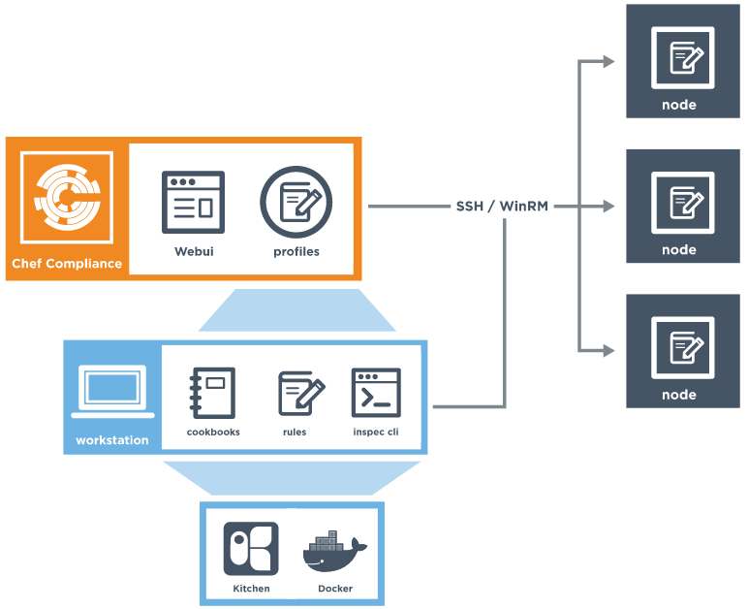
Chef Compliance and InSpec
Chef Compliance leverages InSpec.
InSpec is an open-source run-time framework and rule language used to specify compliance, security, and policy requirements for testing any node in your infrastructure.
Notes:
Chef Compliance leverages InSpec.
InSpec is similar to ServerSpec.
InSpec is an open-source run-time framework and rule language used to specify compliance, security, and policy requirements for testing any node in your infrastructure. The InSpec name refers to “infrastructure specification
InSpec includes a collection of resources to help you write auditing rules quickly and easily using the Compliance DSL.
Use InSpec to examine any node in your infrastructure; run the tests locally or remotely.
Any detected security, compliance, or policy issues are flagged in a log and displayed in reports.
The InSpec audit resource framework is fully compatible with Chef Compliance.

Slide 10
InSpec DSL
InSpec includes a collection of resources to help you write auditing rules quickly and easily using the Compliance DSL
Use InSpec to examine any node in your infrastructure; run the tests locally or remotely.
Any detected security, compliance, or policy issues are flagged in a log and in Chef Compliance, displayed in a GUI.
describe port(80) do
it { should_not be_listening }
end
describe port(443) do
it { should be_listening }
its('protocols') {should include 'tcp'}
end

Slide 11
InSpec DSL
The InSpec audit resource framework is fully compatible with Chef Compliance.
The Compliance DSL is a Ruby DSL for writing audit rules, which includes audit resources that you can invoke.
describe port(80) do
it { should_not be_listening }
end
describe port(443) do
it { should be_listening }
its('protocols') {should include 'tcp'}
end

Slide 12
Compliance Profiles
Compliance profiles exist for many scenarios, such as those created by the Center for Internet Security (CIS)
Chef Compliance maintains profiles as a collection of individual controls that comprise a complete audit.
You can also create your own custom Compliance profiles.
Notes:
Compliance profiles exist for many scenarios, such as those created by the Center for Internet Security (CIS), a non-profit organization that is focused on enhancing the cyber security readiness and response of public and private sector entities.
Chef Compliance maintains profiles as a collection of individual controls that comprise a complete audit. For example, CIS benchmark 8.1.1.1 recommends testing for the maximum size of the audit log.
You can also create your own custom Compliance profiles.

Slide 13
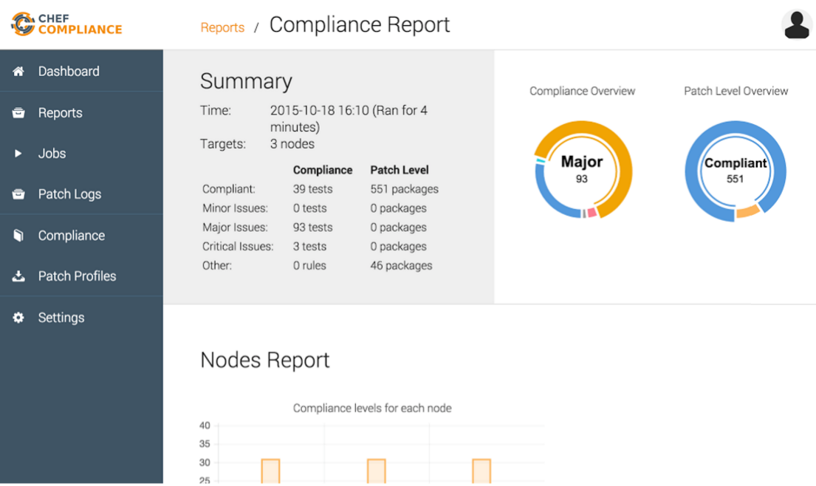
Compliance Web UI
The Chef Compliance web UI provides views into compliance scan results as well as views of Chef Compliance profiles.
You execute scans via the Compliance web UI.

Slide 14

Your Lab Environment for Scanning
We will provide three machines for you to use while performing lab exercises in this course:
One Linux server to install and run Chef Compliance on.
One Windows node and one Linux node to perform Chef Compliance scans against.
Compliance Scans
ssh and HTTP
Server on which to install Chef Compliance
Nodes to run Compliance tests against
Your Laptop
Notes:
These are basic AWS AMIs that we use for Chef training. They have ChefDK installed on them although Chef does not actually need to be installed on these instances in order to run scans.
Instructor Note: Now would be a good time to distribute the hostnames of the three nodes you will assign to each student. You should ask the students to note which one they will use as their Compliance Server and which ones they will use as the target nodes for scans.
For example: ec2-52-91-31-125.compute-1.amazonaws.com = Compliance server.
ec2-54-164-54-218.compute-1.amazonaws.com = Linux Target node.
ec2-54-164-54-210.compute-1.amazonaws.com = Windows Target node.
The login credentials for the Linux nodes is chef/TBD.
The login credentials for the Windows nodes is Administrator/TBD.

Slide 15
Your Lab Environment for Scanning
We will provide two machines for you to use while performing lab exercises in this course:
One Chef Compliance server.
One Linux node to perform Chef Compliance scans against.
Compliance Scans
Node to run Compliance tests against
ssh and HTTP
Chef Compliance
Your Laptop
Notes:
Pop-up:
Everyone shares a Compliance server in this workshop.
No Windows nodes
Atlanta – http://bit.ly/atl-chef-compliance
These are basic AWS AMIs that we use for Chef training. They have ChefDK installed on them although Chef does not actually need to be installed on these instances in order to run scans.
Chef Compliance server login – chef/chef.io
Node ssh credentials – chef/chef.io

Slide 16
Your Lab Environment for Remediation
Compliance
Server
You will also log into your Windows and Linux nodes in order to write remediation and run chef-client in local mode.
This is so you can use those nodes as virtual workstations while writing remediation.
Linux
Win
ssh
Nodes to run Compliance tests against AND use as workstations for writing remediation
Windows Remote Desktop
Your Laptop
Notes:
The dotted lines indicate that those sessions will only be used to write and test remediation. In this scenario, your target nodes will act as virtual workstations.
But all scans will only be run via the Compliance server as indicated in the previous slide.

Slide 17
Your Lab Environment for Remediation
Compliance
Server
You will also log into your Linux node in order to write remediation and run chef-client in local mode.
This is so you can use the node as a virtual workstation while writing remediation.
Linux
ssh
Node to run Compliance tests against AND use as workstations for writing remediation
Your Laptop
Notes:
Pop-up:
Linux only
The dotted lines indicate that those sessions will only be used to write and test remediation. In this scenario, your target nodes will act as virtual workstations.
But all scans will only be run via the Compliance server as indicated in the previous slide.

Slide 18
Logging into the Compliance Server and Linux Node
$ ssh ADDRESS -l chef
Notes:
This is just an explanation. You don't need to log into these machines at this time.
You should use an ssh client like PuTTY or a local command prompt to connect to the remote workstation that we assign to you.
Instead of the command shown in this slide, you could also use this command:
ssh chef@IPADDRESS
For example: ssh chef@52.90.140.22

Slide 19
Login to your node
http://bit.ly/atl-compliance-workstations
Notes:
Pop-up – Let’s do the login now

Slide 20
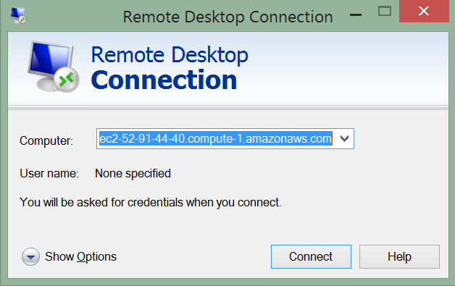
Logging Into the Remote Windows Node
Notes:
Pop-up – No Windows nodes
This is just an explanation. You don't need to log into these machines at this time.
You should have installed on your laptop a Windows Remote Desktop Connection which you'll only use to write remediation later in this course.

Slide 21

Hands-on Legend
GE or Group Exercise: All participants and the instructor do this task together with the instructor often leading the way and explaining things as we proceed.
Lab: You perform this task on your own.

Slide 22
©2016 Chef Software Inc.

Slide 23
Installing Chef Compliance
Installing a Standalone Chef Compliance Server

Slide 24
Configure Chef Compliance
Notes:
Pop-up – Configure, not install

Slide 25
Objectives
After completing this module, you should be able to:
Install the Chef Compliance server.
Perform initial configuration of the Compliance server.
Launch the Compliance Web UI.

Slide 26
Objectives
After completing this module, you should be able to:
Login to the Compliance Web UI.
Notes:
Pop-up – Use a single compliance server. No configuration necessary

Slide 27
Compliance Installation Options
You can install the Chef Compliance server as a an Amazon Machine Images (AMI) instance or as a Standalone installation.
The standalone installation of Chef Compliance server creates a working installation on a single server.
In this course we will use the most common method--the Standalone method.
Notes:
You can install the Chef Compliance server as a an Amazon Machine Images (AMI) instance or as a Standalone installation.
The standalone installation of Chef Compliance server creates a working installation on a single server.
This installation is also useful when you are installing Chef Compliance in a virtual machine, for proof-of-concept deployments, or as a part of a development or testing loop

Slide 28
Group Exercise Standalone Installation
Standalone Installation
ssh into your Compliance Server node
Download and install the chef-compliance-x package on your node
Use chef-compliance-ctl to initially configure Chef Compliance server
Run the Compliance Web UI

Slide 29
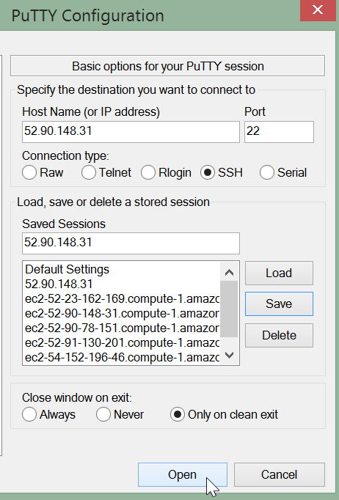
GE: Standalone Installation
ssh into the node you want to install the Compliance server on.
Here is an example of using Putty to do so.

Slide 30
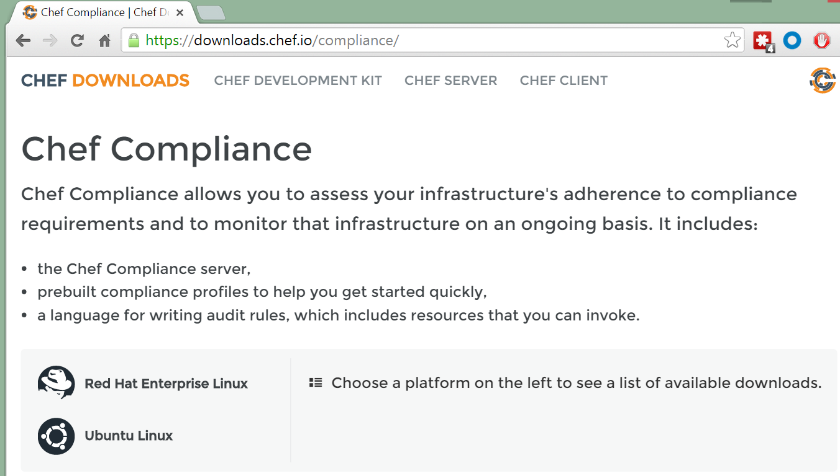
GE: Standalone Installation
From your local laptop, use a web browser to navigate to https://downloads.chef.io/compliance/

Slide 31
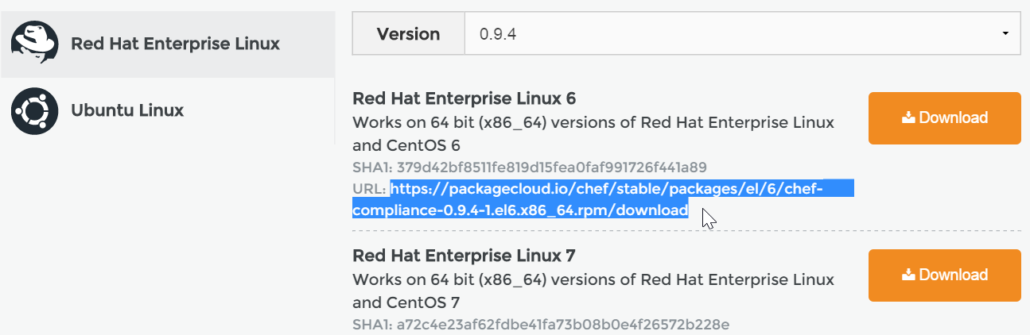
GE: Standalone Installation
From the resulting web page, click the Red Had Linux link and then highlight and copy the URL for the Red Hat Enterprise Linux 6 version. Do not click the Download button.
Notes:
From the resulting web page, highlight and copy the URL for the latest Red Hat Enterprise Linux 6 version. Do not click the Download button. We don't want to download this directly to your laptop but instead we will download it directly to our node.

Slide 32
GE: Install and Install Compliance Package
$ sudo rpm -Uvh https://packagecloud.io/chef/stable/packages/el/6/chef-compliance-0.9.5-2.elX.x86_64.rpm/download
Retrieving https://packagecloud.io/chef/stable/packages/el/6/chef-compliance-0.9.5-2.el6.x86_64.rpm/download
warning: /var/tmp/rpm-tmp.4Mgmgw: Header V4 DSA/SHA2 Signature, key ID 83ef826a: NOKEY
Preparing... ########################################### [200%]
You're about to install chef-compliance!
2:chef-compliance ########################################### [200%]
Notes:
Execute sudo rpm -Uvh https://packagecloud.io/chef/stable/packages/el/6/chef-compliance-0.9.5-2.elX.x86_64.rpm/download but using the URL you just copied to download and install the Compliance package. This could take some time.
Note: The compliance package will be named download at this point.
Instructor Note: The X in this part of the file name - 0.9.2-2.elX - was added so students will paste the latest version and not try to copy/paste the above command verbatim.

Slide 33
GE: Initial Configuration of Compliance
$ sudo chef-compliance-ctl reconfigure
...
- change mode from '' to '0644'
Recipe: sysctl::service
* service[procps] action start
- start service service[procps]
Running handlers:
Running handlers complete
Chef Client finished, 228/224 resources updated in 259.522030572 seconds
chef-compliance Reconfigured!
Notes:
This reconfiguration process could take 5 or more minutes to complete.
Important: Do not use Ctrl c while this is running.
TBD. check length

Slide 34
GE: Create Administrator Credentials
$ sudo chef-compliance-ctl user-create admin chefadmin
20:22:20.388 DEB ▶ Use PostgreSQL backend chef_compliance@227.0.0.2:5432
20:22:20.573 DEB ▶ Save user admin
Notes:
Execute sudo chef-compliance-ctl user-create admin chefadmin .
This will create a user named admin with a password of chefadmin.
In the workplace you should of course create a more secure password.

Slide 35
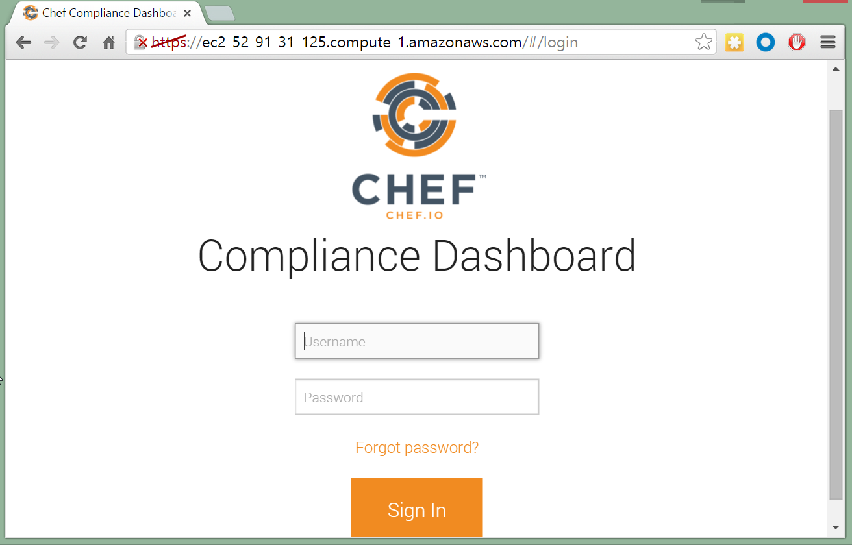
GE: Connect to your Compliance Web UI
From your laptop, point a web browser to the FQDN of your Compliance server.
For example ec2-52-92-32-225.compute-2.amazonaws.com or simply the IP address.
Note: We have not set up SSL so the https strikethrough is fine for now.
Notes:
We have not set up SSL so the https strikethrough is fine for now. In the workplace you would want to use SSL for connections to your Compliance Web UI.

Slide 36
Connect to the Compliance Web UI
From your laptop, point a web browser to the FQDN of our Compliance server.
http://bit.ly/atl-chef-compliance
Note: We have not set up SSL so the https strikethrough is fine for now.
Notes:
Pop-up – One shared Chef Compliance Server
We have not set up SSL so the https strikethrough is fine for now. In the workplace you would want to use SSL for connections to your Compliance Web UI.

Slide 37
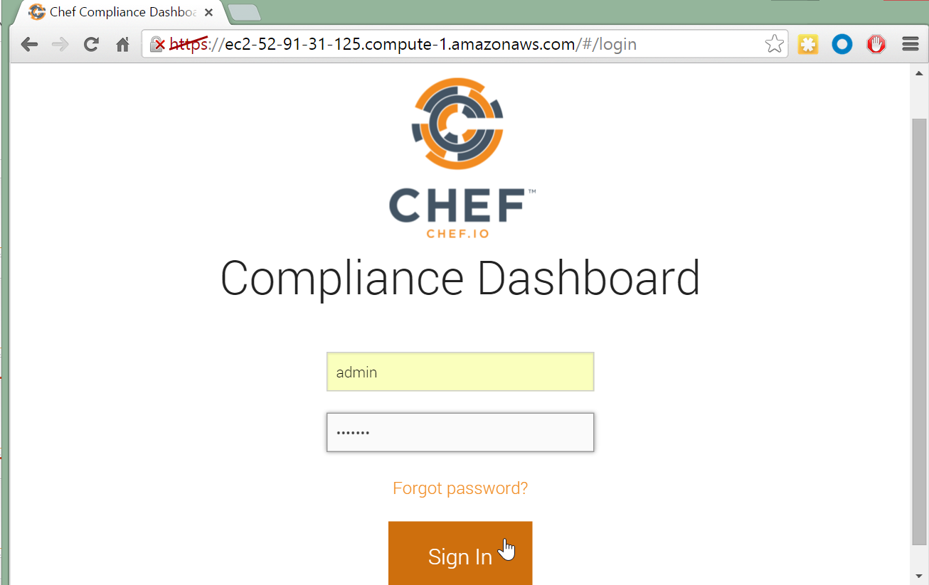
GE: Log into your Compliance Web UI
Log into your Compliance Dashboard using the admin credentials you created previously.
Notes:
We have not set up SSL so the https strikethrough is fine for now. In the workplace you would want to use SSL for connections to your Compliance Web UI.

Slide 38
Log into the Compliance Web UI
Log into your Compliance Dashboard using the admin credentials provided.
Notes:
Pop-up: We are sharing a compliance server

Slide 39
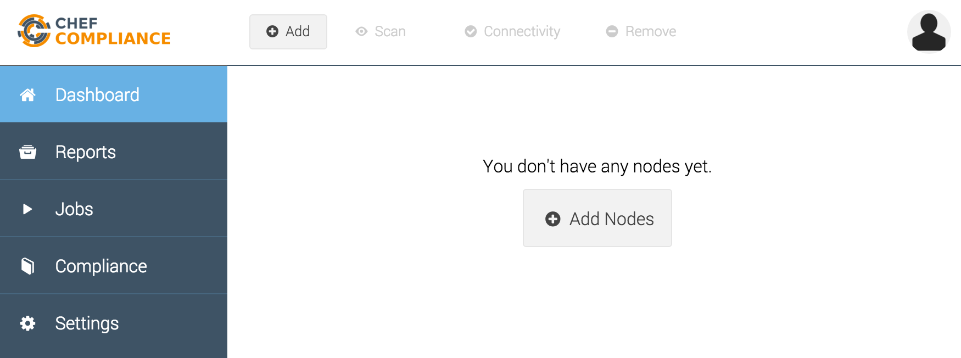
Test your Compliance Web UI
You should now see an empty Compliance Dashboard.
Notes:
In the workplace you would want to use SSL for connections to your Compliance Web UI.
https://docs.chef.io/install_compliance.html > Configure SSL

Slide 40
Compliance Upgrades
If at some point you want to install a newer version of Chef Compliance, you can simply install the new version over the old version as follows:
sudo rpm -Uvh https://packagecloud.io/chef/stable/packages/<rest of filename>
sudo chef-compliance-ctl reconfigure
sudo chef-compliance-ctl restart
Relaunch the Compliance Web UI
Notes:
Instructor Note: If you needed to downgrade Compliance to a previous version, the `--oldpackage' option will do that for you. In the following example, the `https://package...` would be the version of the old package that you want to downgrade to:
sudo rpm -Uvh --oldpackage https://packagecloud.io/chef/stable/packages/el/6/chef-compliance-0.9.6-1.el6.x86_64.rpm/download

Slide 41
Review Questions
What is ...? ______________________________
Which is the correct answer?
answer
answer
answer
answer
Capable of carrying on a conversation
Explain

Slide 42
©2016 Chef Software Inc.

Slide 43
Running Scans, Remediation, and Testing
Configuring the Chef Compliance Server to Run Scans and Writing Remediation Recipes

Slide 44
Objectives
After completing this module, you should be able to:
Add a node to test for compliance.
Run a Compliance scan.
Test for compliance with InSpec from the command line interface.
Remediate a compliance issue.
Use Test Kitchen to test your remediation.
Rescan the node and ensure compliance.

Slide 45
Adding a Node to Scan
To add a node you'll need:
The IP address or FQDN of the nodes to be tested.
Access configuration (ssh or WinRM).
The node's username and password OR
The node's username plus security key pair.

Slide 46
Group Exercise: Adding a Node to Scan
Add a Linux Node to Scan
Test connectivity
Note: In the next module you will perform the same exercises as in this module but using a Windows node as your target node.

Slide 47
Group Exercise: Adding a Node to Scan
Add a Linux Node to Scan
Test connectivity
Notes:
Pop-up – No Windows

Slide 48
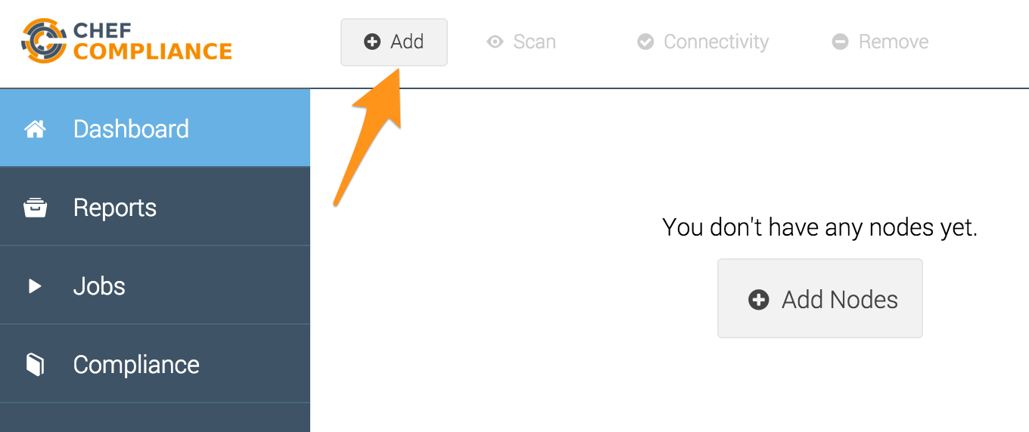
GE: Adding a Node to Scan
From your Chef Compliance Dashboard, click Add Node.

Slide 49
Adding a Node to Scan
From your Chef Compliance Dashboard, click Add Node.

Slide 50
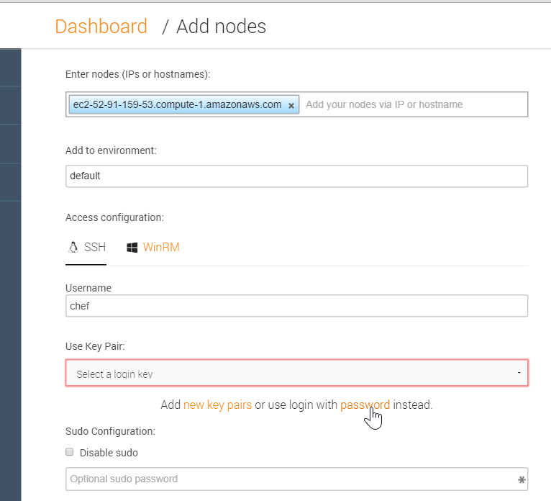
GE: Adding a Node
From the resulting page, enter the node's FQDN or IP address.
Select the default environment. You may need to type the default environment initially.
Accept the default SSH Access configuration
Type chef in the username field.
Click the password link as shown in this illustration.
Notes:
Be sure you are using the hostname of the target node that you noted previously in class.
In the workplace, the target node's username and password will likely be different than shown in this example.
We'll discuss using key pair access later in the module.

Slide 51
Adding a Node
From the resulting page, enter the node's FQDN or IP address.
Use your name for the environment field.
Accept the default SSH Access configuration
Type chef in the username field.
Click the password link as shown in this illustration.
Notes:
Pop-up – Create a unique environment
Be sure you are using the hostname of the target node that you noted previously in class.
In the workplace, the target node's username and password will likely be different than shown in this example.
We'll discuss using key pair access later in the module.

Slide 52
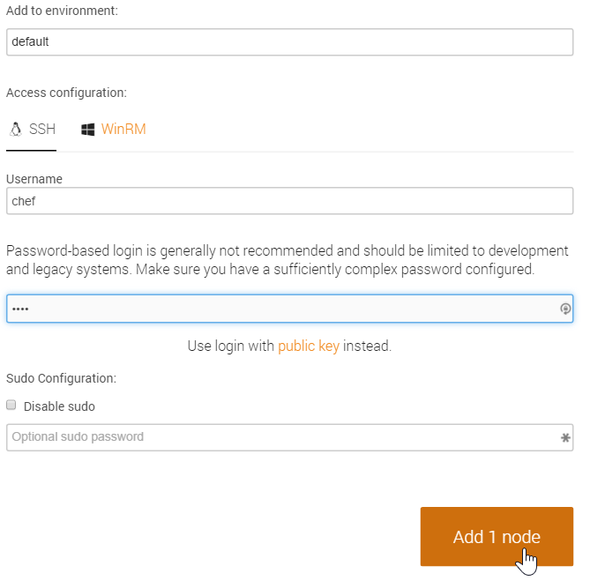
GE: Adding a Node to Scan
Type the password (chef) in the password field.
Click the Add 1 node button as shown in this illustration.

Slide 53
Adding a Node to Scan
Type the password (chef.io) in the password field.
Click the Add 1 node button as shown in this illustration.
Notes:
Pop-up – chef.io is the password

Slide 54
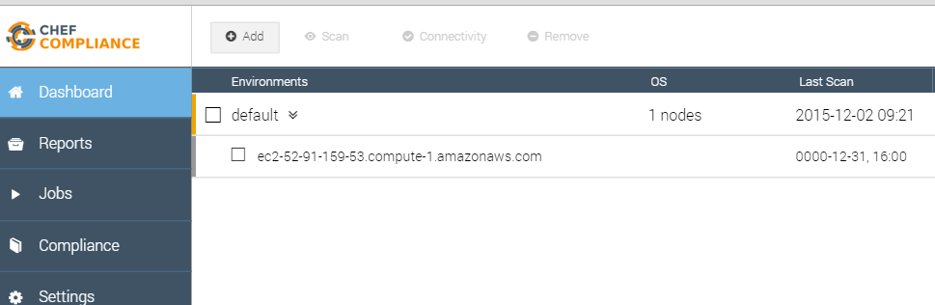
GE: Adding a Node to Scan
At this point your Compliance Dashboard should list the node you just added.

Slide 55
Adding a Node to Scan
At this point your Compliance Dashboard should list the node you just added.
Notes:
Pop-up – and everyone else’s nodes

Slide 56
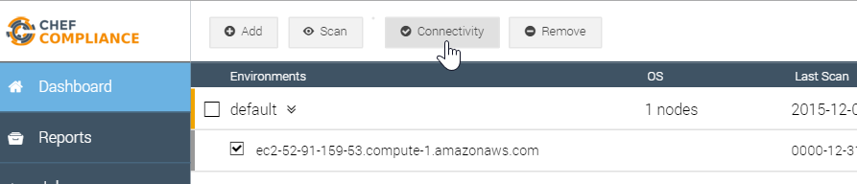
GE: Testing Connectivity to your Node
Click the check box next to your node and then click the Connectivity button.

Slide 57
Testing Connectivity to your Node
Click the check box next to your node and then click the Connectivity button.

Slide 58
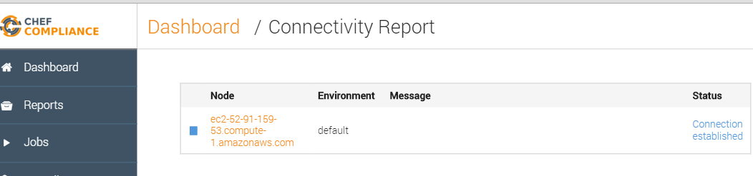
GE: Testing Connectivity to your Node
The Status column of you node should now indicate Connection established.
Notes:
If your Status column does not indicate `Connection established`, please notify the instructor.

Slide 59
GE: Testing Connectivity to your Node
The Status column of you node should now indicate Connection established.
Notes:
If your Status column does not indicate `Connection established`, please notify the instructor.

Slide 60
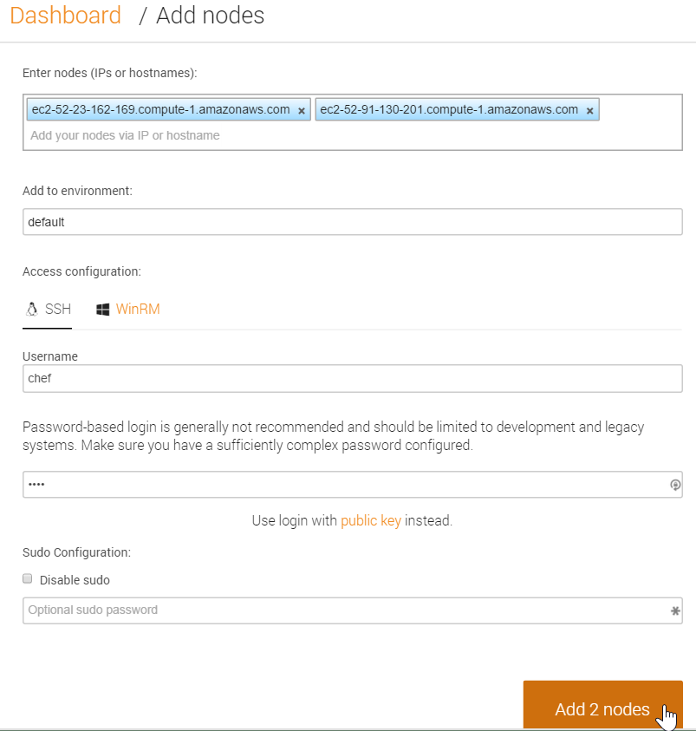
Adding Nodes in Bulk
You could add additional nodes by simply repeating the previous steps.
You could also add a number of nodes at once by separating each hostname or IP address with a comma or a space, as shown in this illustration.
Chef Compliance also supports bulk loading of nodes via API.
Notes:
As you may have noticed, you could add additional nodes by simply repeating the previous steps.
You could also add a number of nodes at once by separating each hostname or IP address with a comma or a space, as shown in this illustration.
Chef Compliance also supports bulk loading of nodes via API.

Slide 61
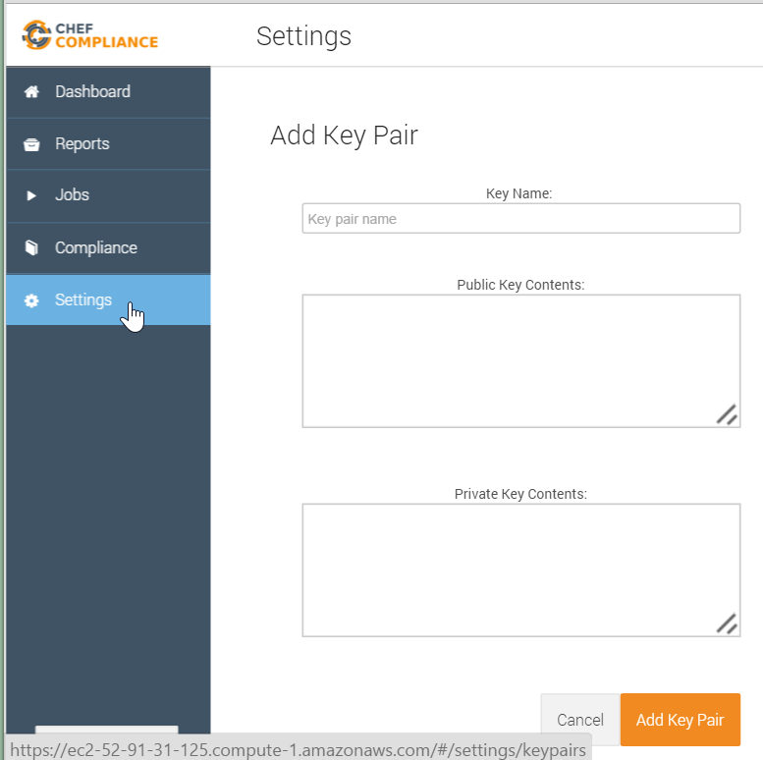
Key Pairs
In the workplace, using security key pairs would be a more secure method for connecting to nodes than using the password method.
By clicking Settings > Add New Key Pair you will see where to paste your private and public keys.
Notes:
In the workplace, using security key pairs would be a more secure method for connecting to nodes than using the password method we are using in class.
By clicking `Settings > Add New Key Pair` you will see where to paste your private and public keys.

Slide 62
Running Compliance Scans
You can run Compliance scans on demand or schedule them to run at a later time.
Chef Compliance maintains profiles as a collection of individual controls that comprise a complete audit.
As mentioned previously, Chef Compliance comes with a few reference profiles of various compliance policies that you can leverage or use as examples to create your own.

Slide 63
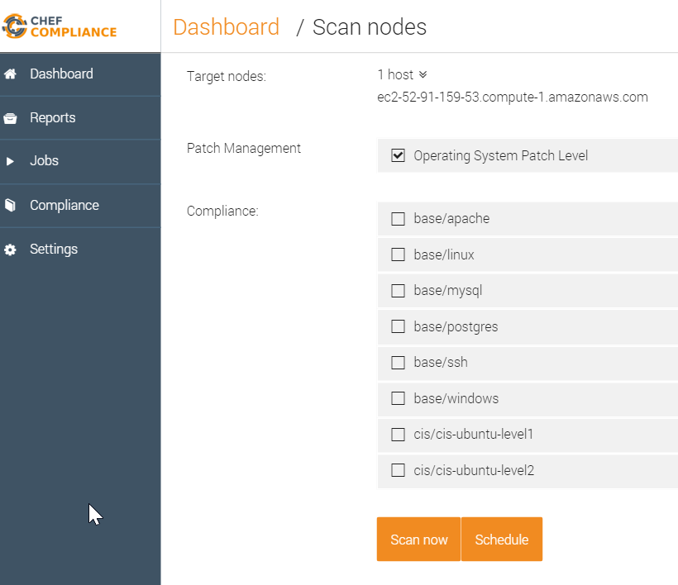
Compliance Profiles Used in Scans
This image shows the default Compliance Profiles as accessed from the Scan Nodes page.
You should be thoughtful with which profiles choose.
Notice how you can also choose to run a scan on demand or schedule a scan.
Notes:
This image shows the default Compliance Profiles as accessed from the Scan Nodes page. This page displays when you select nodes to scan and then click the Scan button.
You'll access the profiles in a moment. These profiles determine what will be scanned on your nodes.
You should be thoughtful with which profiles choose since the more you choose to run, the longer it will take to execute the scan.
Notice how you can also choose to run a scan on demand (Scan now) or schedule a scan to run at a later time.

Slide 64
Group Exercise: Running a Scan
Run a Compliance scan.
View the output of a scan.

Slide 65
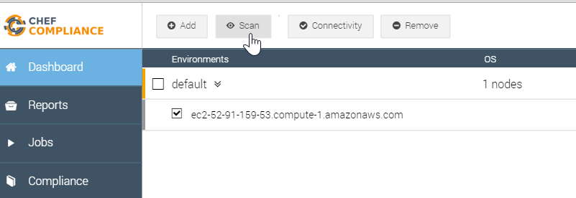
GE: Running a Scan
Click the check box next to your node and then click the Scan button.

Slide 66
Running a Scan
Click the check box next to your node and then click the Scan button.

Slide 67
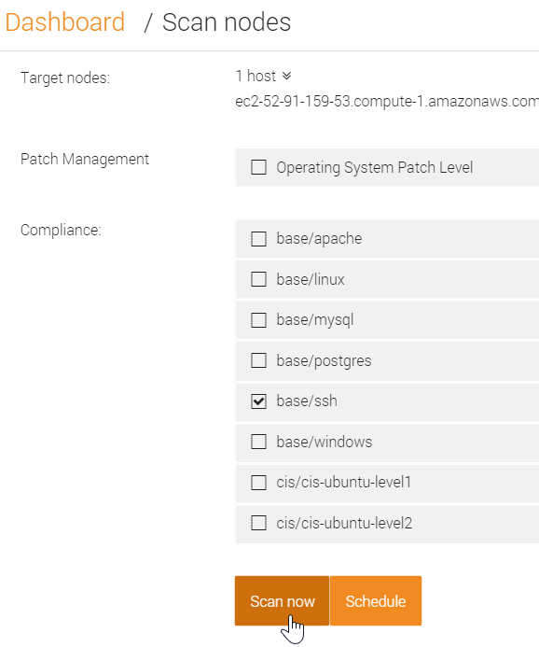
GE: Running a Scan
From the resulting page, check the base/ssh profile and uncheck any other check boxes.
Click the Scan now button.

Slide 68
Running a Scan
From the resulting page, check the base/ssh profile and uncheck any other check boxes.
Click the Scan now button.

Slide 69
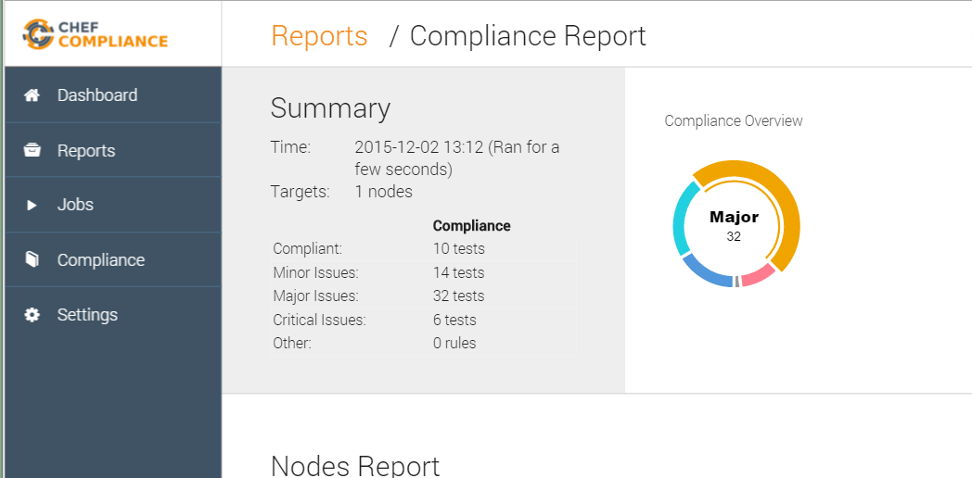
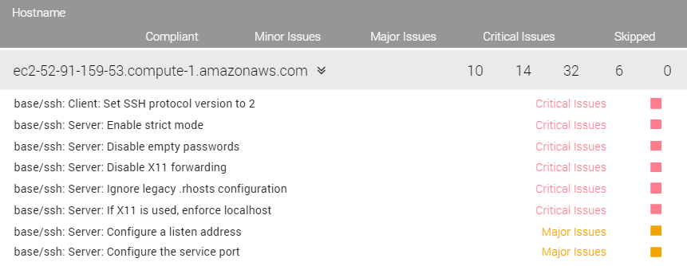
Scan Results
A Compliance Report should now display and your scan results should be similar to that shown here.
Notice how in the upper Summary section in this example, 30 tests were compliant and 6 tests show critical issues with ssh.
Notes:
There are also 6 critical issues related to ssh on the target node.
Instructor Note: This and the following slide should be used for a discussion of the scan results. The group exercise continues after that.

Slide 70
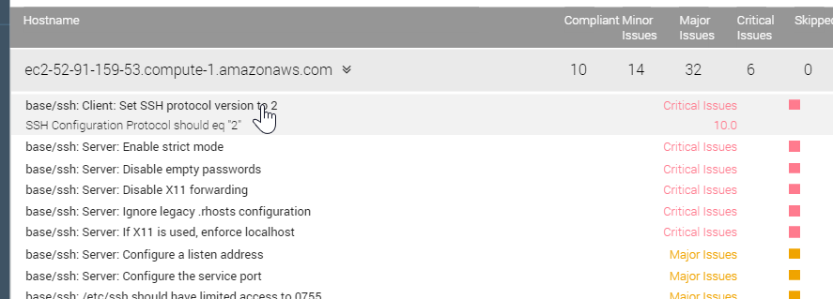
Scan Results
The bottom half of the Compliance Report shown here has a table of details of test results.
These are sorted by severity.
If you click an issue as shown here, a bit more information about the issue displays.
Notes:
The bottom half of the Compliance Report has a table of details of test results.
These are sorted by severity so the critical issues are listed at the top and the compliant items are at the bottom of the list.
If you click an issue as shown here, a bit more information about the issue displays, but that's not really telling us much.

Slide 71
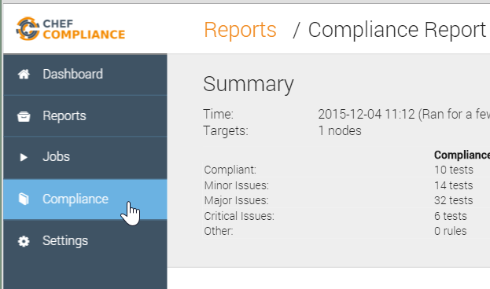
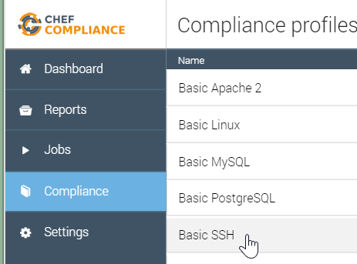
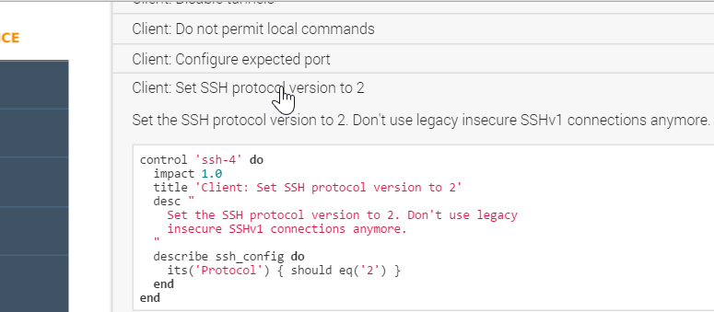
GE: Profile
To view the InSpec code that comprises this profile, do the following:
Click the Compliance button.
Click the relevant profile (Basic SSH).
Scroll down and click the `Set SSH protocol version to 2` profile.
Notes:
Instructor Note: Now we continue the group exercise but you should stop as needed to explain what this code means.

Slide 72
Profile
To view the InSpec code that comprises this profile, do the following:
Click the Compliance button.
Click the relevant profile (Basic SSH).
Scroll down and click the `Set SSH protocol version to 2` profile.
Notes:
Instructor Note: Now we continue the group exercise but you should stop as needed to explain what this code means.

Slide 73
Discussion: InSpec Profile Code
Let's discuss what this profile is doing.
The `impact` of 1.0 indicates this is a Critical issue.
The `title` is what populates the Compliance Report issue title.
Notes:
Let's discuss what this profile is doing.
TBD The impact of 1.0 indicates this is a Major issue if it the scanned node violates what is in this code.

Slide 74
Discussion: InSpec Profile Code
The desc is typically human-readable description sourced from the CIS or source doc.
The `describe` section is the actual test that is executed.
Notes:
The desc is typically human-readable description sourced from the CIS or source doc.
The describe value is the actual test. In this case, this is saying the protocol for `ssh_config` Protocol should be `2`. If the actual value from the node is not Protocol 2, the Critical issue is reported as in this case.
So when you run a scan, the Compliance Server connects to the node using the configuration we specified, in this case ssh, and then it will run this set of code, this InSpec control, on that node. The Compliance Server translates the InSpec code into ssh commands when it transmits across the wire.
No agent or client is required to be running on the target node for this work.

Slide 75
Example: Node's ssh config
$ more /etc/ssh/ssh_config
# IdentityFile ~/.ssh/identity
# IdentityFile ~/.ssh/id_rsa
# IdentityFile ~/.ssh/id_dsa
# Port 22
# Protocol 2,1
# Cipher 3des

Slide 76
Let's Remediate the Issue
Now that we've identified the ssh version issue, let's write a recipe on the target node to remediate the issue.
Then we'll run the compliance scan again to see if we successfully remediated the issue.
Note: In this course we will write a recipe directly on the node that we're running scans on. Of course in a production environment you will likely write such recipes locally and upload them to Chef Server. Then the nodes would convergence the recipes on their next chef-client run.

Slide 77
GE: Remediating the Issue
Log into your target node.
Start writing a remediation recipe on that node.
Test the recipe with Test Kitchen.
Rescan the node and ensure compliance.

Slide 78
Group Exercise: Remediating the Issue
Log into your target node.
Start writing a remediation recipe on that node.
Test the recipe with Test Kitchen.
Rescan the node and ensure compliance.

Slide 79
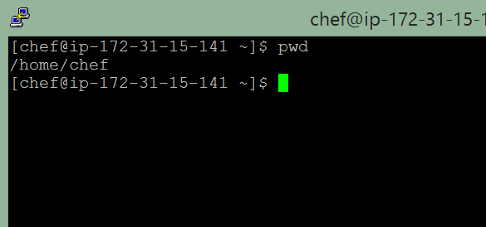
GE: Remediating the Issue
Log into your target node (not your compliance server node) using ssh and ensure you are in the home directory.
Note: You can install the editor of your choice on the target node after you log in. The only editor currently installed on these training nodes is vi. Instructions to install nano, emacs, and vim are below in your participant guide.
Notes:
If you prefer to use emacs, nano, or vim to edit files on this training node, please do so now. For nano: sudo chef-apply -e "package 'nano'"
For emacs: sudo chef-apply -e "package 'emacs'"
For vim: sudo chef-apply -e "package 'vim'"
Instructor Note: Allow the students time to install vim, emacs, or nano at this time in case they prefer not to use the existing vi editor.

Slide 80
Remediating the Issue
Log into your target node using ssh and ensure you are in the home directory.
Notes:
Pop-up – The editors are pre-installed in these instances

Slide 81
GE: Create an SSH Cookbook and CD to it
$ mkdir -p cookbooks
$ cd cookbooks
Create a `cookbooks` directory and navigate into it.

Slide 82
Create and change to a ‘cookbooks’ directory
$ mkdir -p cookbooks
$ cd cookbooks
Create a `cookbooks` directory and navigate into it.

Slide 83
GE: Create an SSH Cookbook
$ chef generate cookbook ssh
Compiling Cookbooks...
Recipe: code_generator::cookbook
* directory[/home/chef/cookbooks/ssh] action create
- create new directory /home/chef/cookbooks/ssh
...
- create new file /home/chef/cookbooks/ssh/recipes/default.rb
- update content in file /home/chef/cookbooks/ssh/recipes/default.rb from none to b702c7
(diff output suppressed by config)

Slide 84
Create an SSH Cookbook
$ chef generate cookbook ssh
Compiling Cookbooks...
Recipe: code_generator::cookbook
* directory[/home/chef/cookbooks/ssh] action create
- create new directory /home/chef/cookbooks/ssh
...
- create new file /home/chef/cookbooks/ssh/recipes/default.rb
- update content in file /home/chef/cookbooks/ssh/recipes/default.rb from none to b702c7
(diff output suppressed by config)

Slide 85
GE: Create an SSH Client Recipe
$ chef generate recipe ssh client
Compiling Cookbooks...
Recipe: code_generator::recipe
* directory[./ssh/spec/unit/recipes] action create (up to date)
* cookbook_file[./ssh/spec/spec_helper.rb] action create_if_missing (up to date)
...
- create new file ./ssh/recipes/client.rb
- update content in file ./ssh/recipes/client.rb from none to 9c833a
(diff output suppressed by config)
Notes:
In this step, instead of modifying the default recipe, we will create a new `ssh client` recipe.
This is because a default ssh cookbook probably affects an ssh server config and ssh client config and we only want to affect an ssh client. TBD - why?

Slide 86
Create an SSH Client Recipe
$ chef generate recipe ssh client
Compiling Cookbooks...
Recipe: code_generator::recipe
* directory[./ssh/spec/unit/recipes] action create (up to date)
* cookbook_file[./ssh/spec/spec_helper.rb] action create_if_missing (up to date)
...
- create new file ./ssh/recipes/client.rb
- update content in file ./ssh/recipes/client.rb from none to 9c833a
(diff output suppressed by config)
Notes:
In this step, instead of modifying the default recipe, we will create a new `ssh client` recipe.
This is because a default ssh cookbook probably affects an ssh server config and ssh client config and we only want to affect an ssh client. TBD - why?

Slide 87
GE: Create an SSH Config Template
$ chef generate template ssh ssh_config.erb -s /etc/ssh/ssh_config
Compiling Cookbooks...
Recipe: code_generator::template
* directory[./ssh/templates/default] action create
- create new directory ./ssh/templates/default
* file[./ssh/templates/default/ssh_config.erb] action create
- create new file ./ssh/templates/default/ssh_config.erb
- update content in file ./ssh/templates/default/ssh_config.erb from none to 86eb9b
(diff output suppressed by config)
Notes:
In this step, we want to create a template file to manage our `ssh_config` file.
The `-s` option in this command takes the contents of the current `/etc/ssh/ssh_config` file and places it in the `ssh_config.erb` file.
Instructor Note: At this time you might want to show the class the contents of `/home/chef/cookbooks/ssh/templates/default/ssh_config.erb` to illustrate how the contents of the current `/etc/ssh/ssh_config` file is now in the `ssh_config.erb` file.

Slide 88
Create an SSH Config Template
$ chef generate template ssh ssh_config.erb -s /etc/ssh/ssh_config
Compiling Cookbooks...
Recipe: code_generator::template
* directory[./ssh/templates/default] action create
- create new directory ./ssh/templates/default
* file[./ssh/templates/default/ssh_config.erb] action create
- create new file ./ssh/templates/default/ssh_config.erb
- update content in file ./ssh/templates/default/ssh_config.erb from none to 86eb9b
(diff output suppressed by config)
Notes:
In this step, we want to create a template file to manage our `ssh_config` file.
The `-s` option in this command takes the contents of the current `/etc/ssh/ssh_config` file and places it in the `ssh_config.erb` file.
Instructor Note: At this time you might want to show the class the contents of `/home/chef/cookbooks/ssh/templates/default/ssh_config.erb` to illustrate how the contents of the current `/etc/ssh/ssh_config` file is now in the `ssh_config.erb` file.

Slide 89
GE: Write the Client Recipe
$ ~/cookbooks/ssh/recipes/client.rb
# Cookbook Name:: ssh
# Recipe:: client
# Copyright (c) 2035 The Authors, All Rights Reserved.
template '/etc/ssh/ssh_config' do
source 'ssh_config.erb'
owner 'root'
group 'root'
mode '0644'
end
Notes:
Edit the `~/cookbooks/ssh/recipes/client.rb` file and add the contents shown here.

Slide 90
Write the Client Recipe
$ ~/cookbooks/ssh/recipes/client.rb
# Cookbook Name:: ssh
# Recipe:: client
# Copyright (c) 2035 The Authors, All Rights Reserved.
template '/etc/ssh/ssh_config' do
source 'ssh_config.erb'
owner 'root'
group 'root'
mode '0644'
end
Notes:
Edit the `~/cookbooks/ssh/recipes/client.rb` file and add the contents shown here.

Slide 91
GE: Testing the Recipe
Log into your target node.
Write a remediation recipe on that node.
Test the recipe with Test Kitchen.
Test for compliance with InSpec from the CLI
Rescan the node and ensure compliance.

Slide 92
Group Exercise: Testing the Recipe
Log into your target node.
Write a remediation recipe on that node.
Test the recipe with Test Kitchen.
Test for compliance with InSpec from the command line interface.
Rescan the node and ensure compliance.

Slide 93
Navigate to your SSH Cookbook
$ cd ~/cookbooks/ssh/
Notes:
To test your recipe, first navigate to where the recipe lives

Slide 94
GE: Navigate to your SSH Cookbook
$ cd ~/cookbooks/ssh/
Notes:
To test your recipe, first navigate to where the recipe lives

Slide 95
GE: Edit your .kitchen.yml -- Part 1
$ ~/cookbooks/ssh/.kitchen.yml
---
driver:
name: docker
provisioner:
name: chef_zero
Notes:
Edit your `.kitchen.yml` as shown here and on the following slide.
Because our node is an EC2 AWS instance, we need to change the driver from vagrant to docker. docker should already be installed on the EC2 AWS training instances.

Slide 96
Edit your .kitchen.yml -- Part 1
$ ~/cookbooks/ssh/.kitchen.yml
---
driver:
name: docker
provisioner:
name: chef_zero
Notes:
Edit your `.kitchen.yml` as shown here and on the following slide.
Because our node is an EC2 AWS instance, we need to change the driver from vagrant to docker. docker should already be installed on the EC2 AWS training instances.

Slide 97
GE: Edit your .kitchen.yml -- Part 2
$ ~/cookbooks/ssh/.kitchen.yml
platforms:
# - name: ubuntu-34.04
- name: centos-6.7
suites:
- name: default
run_list:
- recipe[ssh::default]
attributes:
Notes:
Also comment the ubuntu platform line and change the centos platform to `centos-6.7', which should be the version running on the training instance.
To confirm the centos release, you could execute `more /etc/*-release`
::::::::::::::
/etc/centos-release
::::::::::::::
CentOS release 6.7 (Final)

Slide 98
Edit your .kitchen.yml -- Part 2
$ ~/cookbooks/ssh/.kitchen.yml
platforms:
# - name: ubuntu-34.04
- name: centos-6.7
suites:
- name: default
run_list:
- recipe[ssh::default]
attributes:
Notes:
Also comment the ubuntu platform line and change the centos platform to `centos-6.7', which should be the version running on the training instance.
To confirm the centos release, you could execute `more /etc/*-release`
::::::::::::::
/etc/centos-release
::::::::::::::
CentOS release 6.7 (Final)

Slide 99
GE: Edit your .kitchen.yml -- Part 3
$ ~/cookbooks/ssh/.kitchen.yml
platforms:
# - name: ubuntu-34.04
- name: centos-6.7
suites:
- name: client
run_list:
- recipe[ssh::client]
attributes:
Notes:
Finally, change the suites name to `client' and the run_list recipe name to `ssh:client`.
run_list:
- recipe[ssh::client]

Slide 100
Edit your .kitchen.yml -- Part 3
$ ~/cookbooks/ssh/.kitchen.yml
platforms:
# - name: ubuntu-34.04
- name: centos-6.7
suites:
- name: client
run_list:
- recipe[ssh::client]
attributes:
Notes:
Finally, change the suites name to `client' and the run_list recipe name to `ssh:client`.
run_list:
- recipe[ssh::client]

Slide 101
GE: Run `kitchen list` from ~/cookbooks/ssh/
$ kitchen list
Instance Driver Provisioner Verifier Transport Last Action
client-centos-67 Docker ChefZero Busser Ssh <Not Created> :
Notes:
Now run `kitchen list` from the ~/cookbooks/ssh directory. This command will tell you if you have a typo in your `.kitchen.yml`.

Slide 102
Run `kitchen list` from ~/cookbooks/ssh/
$ kitchen list
Instance Driver Provisioner Verifier Transport Last Action
client-centos-67 Docker ChefZero Busser Ssh <Not Created> :
Notes:
Now run `kitchen list` from the ~/cookbooks/ssh directory. This command will tell you if you have a typo in your `.kitchen.yml`.

Slide 103
GE: Run `kitchen converge`
$ kitchen converge
-----> Starting Kitchen (v3.4.2)
-----> Creating <client-centos-67>...
Sending build context to Docker daemon 32.26 kB
Sending build context to Docker daemon
Step 0 : FROM centos:centos6
---> 3bbbf0aca359
...
Chef Client finished, 0/3 resources updated in 03 seconds
Finished converging <client-centos-67> (0m28.27s).
-----> Kitchen is finished. (0m30.32s)
zlib(finalizer): the stream was freed prematurely.
Notes:
Now run `kitchen converge` from the ~/cookbooks/ssh directory.
`kitchen converge` will:
Launch a docker container.
Place the cookbook into the docker container.
Install chef-client in the docker container.
Run chef zero (i.e., chef-client in local mode) across the client recipe.
The end result will be that it should write out the ssh_conf to the appropriate location (i.e., /etc/ssh/ssh_config).
It could take a couple minutes or so for this command to complete.

Slide 104
Run `kitchen converge`
$ kitchen converge
-----> Starting Kitchen (v3.4.2)
-----> Creating <client-centos-67>...
Sending build context to Docker daemon 32.26 kB
Sending build context to Docker daemon
Step 0 : FROM centos:centos6
---> 3bbbf0aca359
...
Chef Client finished, 0/3 resources updated in 03 seconds
Finished converging <client-centos-67> (0m28.27s).
-----> Kitchen is finished. (0m30.32s)
zlib(finalizer): the stream was freed prematurely.
Notes:
Now run `kitchen converge` from the ~/cookbooks/ssh directory.
`kitchen converge` will:
Launch a docker container.
Place the cookbook into the docker container.
Install chef-client in the docker container.
Run chef zero (i.e., chef-client in local mode) across the client recipe.
The end result will be that it should write out the ssh_conf to the appropriate location (i.e., /etc/ssh/ssh_config).
It could take a couple minutes or so for this command to complete.

Slide 105
What We've Done So Far
In the preceding exercises, we began writing a remediation recipe on our target node.
We also tested the recipe with Test Kitchen.
But have we even addressed the "Set the SSH protocol version to 2" issue?
Notes:
In the preceding exercises we began writing a remediation recipe on our target node.
We also tested the recipe with Test Kitchen.
But have we even addressed the "Set the SSH protocol version to 2" issue?
If you answered "no", you are correct. In a little while we will modify our recipe to address the "Set the SSH protocol version to 2" issue.
But first, let's add an InSpec Verifier.

Slide 106
InSpec Verifier
An InSpec verifier is responsible for running tests post-converge to confirm that the instance is in a known/consistent state.
InSpec can be used as a verifier for test kitchen. After the converge, the kitchen verify step uses a verifier such as bats, serverspec, or inspec to verify the state of the test instance.

Slide 107
GE: Adding an InSpec Verification
Log into your target node.
Write a remediation recipe on that node.
Test the recipe with Test Kitchen.
Test for compliance with InSpec from the command line interface
Rescan the node and ensure compliance.

Slide 108
Adding an InSpec Verification
Log into your target node.
Write a remediation recipe on that node.
Test the recipe with Test Kitchen.
Test for compliance with InSpec from the command line interface
Rescan the node and ensure compliance.

Slide 109
GE: Create the `inspec` Directory
$ mkdir -p ~/cookbooks/ssh/test/integration/client/inspec

Slide 110
Create the `inspec` Directory
$ mkdir -p ~/cookbooks/ssh/test/integration/client/inspec

Slide 111
GE: Create the `client_spec.rb' file
~/cookbooks/ssh/test/integration/client/inspec/client_spec.rb
control 'ssh-4' do
impact 3.0
title 'Client: Set SSH protocol version to 2'
desc "
Set the SSH protocol version to 2. Don't use legacy
insecure SSHv3 connections anymore.
"
describe ssh_config do
its('Protocol') { should eq('2') }
end
end
Notes:
See the following slide for an example of a handy way to populate this file.

Slide 112
Create the `client_spec.rb' file
~/cookbooks/ssh/test/integration/client/inspec/client_spec.rb
control 'ssh-4' do
impact 1.0
title 'Client: Set SSH protocol version to 2'
desc "
Set the SSH protocol version to 2. Don't use legacy
insecure SSHv3 connections anymore.
"
describe ssh_config do
its('Protocol') { should eq('2') }
end
end
Notes:
See the following slide for an example of a handy way to populate this file.

Slide 113
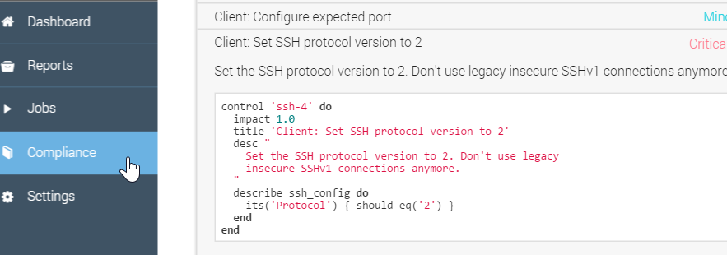
Example of Creating the `client_spec.rb' file
One handy way to populate the preceding `client_spec.rb' is to use the Compliance Web UI and copy the InSpec code found in the relevant Compliance profile: Compliance > Base SSH > Set the SSH protocol version to 2
Notes:
One handy way to populate the preceding `client_spec.rb' is to use the Compliance Web UI and copy the InSpec control code found in the relevant Compliance profile.
Then you can paste it into the `client_spec.rb' file to save yourself some typing.

Slide 114
GE: Add the InSpec Verifier
~/cookbooks/ssh/.kitchen.yml
---
driver:
name: docker
provisioner:
name: chef_zero
# Uncomment the following verifier to leverage Inspec instead of Busser (the
# default verifier)
verifier:
name: inspec
platforms:
# - name: ubuntu-14.04
- name: centos-6.7
Notes:
Edit ~/cookbooks/ssh/.kitchen.yml and uncomment the `verifier` and `name: inspec' lines.
verifier:
name: inspec
Note: Be sure to remove any extra spaces that may precede `verifier`.

Slide 115
GE: Run the Verifier
$ cd ~/cookbooks/ssh
$ kitchen verify
-----> Starting Kitchen (v1.4.2)
/opt/chefdk/embedded/lib/ruby/gems/2.1.0/gems/httpclient-2.6.0.1/lib/httpclient/webagent-cookie.rb:458: warning: already initialized constant HTTPClient::CookieManager
...
Preparing files for transfer
Transferring files to <client-centos-67>
Finished verifying <client-centos-67> (0m0.00s).
-----> Kitchen is finished. (0m1.91s)
Notes:
Ensure you are in ~/cookbooks/ssh and run `kitchen verify`.
InSpec verifier does not work with kitchen docker so we'll look at that issue in a moment.
TBD explain the output

Slide 116
Running InSpec from the command line interface (CLI)
InSpec is an executable application.
InSpec can execute on remote hosts, including docker
containers.

Slide 117
GE: What is your Docker ID?
$ sudo docker ps
CONTAINER ID IMAGE COMMAND CREATED STATUS PORTS NAMES
5b51a4237437 d5b8fd3299b4 "/usr/sbin/sshd -D - 41 minutes ago Up 41 minutes 0.0.0.0:32768->22/tcp grave_davinci
Notes:
Below is an example of the details of the `sudo docker ps` command. This shows one docker container running.
You should only have only one docker container running too.
You'll need the Container ID for the next step so copy your Container ID, which is the first value that is not a header.
CONTAINER ID IMAGE COMMAND CREATED STATUS PORTS NAMES
5b51a4237437 d5b8fd3299b4 "/usr/sbin/sshd -D - 41 minutes ago Up 41 minutes 0.0.0.0:32768->22/tcp grave_davinci

Slide 118
What is your Docker ID?
$ sudo docker ps
CONTAINER ID IMAGE COMMAND CREATED STATUS PORTS NAMES
5b51a4237437 d5b8fd3299b4 "/usr/sbin/sshd -D - 41 minutes ago Up 41 minutes 0.0.0.0:32768->22/tcp grave_davinci
Notes:
Below is an example of the details of the `sudo docker ps` command. This shows one docker container running.
You should only have only one docker container running too.
You'll need the Container ID for the next step so copy your Container ID, which is the first value that is not a header.
CONTAINER ID IMAGE COMMAND CREATED STATUS PORTS NAMES
5b51a4237437 d5b8fd3299b4 "/usr/sbin/sshd -D - 41 minutes ago Up 41 minutes 0.0.0.0:32768->22/tcp grave_davinci

Slide 119
GE: Running InSpec from the CLI
$ inspec exec ~/cookbooks/ssh/test/integration/client/inspec/client_spec.rb -t docker://CONTAINER_ID
Failures:
1) SSH Configuration Protocol should eq "2"
Failure/Error: its('Protocol') { should eq('2') }
expected: "2"
got: nil
(compared using ==)
# ./test/integration/client/inspec/client_spec.rb:9:in `block (3 levels) in load'
Finished in 0.79369 seconds (files took 0.7207 seconds to load)
1 example, 1 failure
Failed examples:
rspec # SSH Configuration Protocol should eq "2"
Notes:
Run this inspec command using the container ID you just copied, replacing CONTAINER_ID in the example.
`inspec exec ~/cookbooks/ssh/test/integration/client/inspec/client_spec.rb -t docker://CONTAINER_ID`
While the image of the output may be hard to see, the output is also pasted below. Notice how inspec from the command line also found the "SSH Configuration Protocol should eq "2" non compliance issue.
Running InSpec in this way can uncover more complex issues than the basic issue we are remediating in this module.
TBD: Nathen:"I think it’s a critical part of the remediation b/c you want to make sure you are testing the same thing locally
​[12:25 PM]
in this case, it’s a pretty easy fix so you might feel you don’t need to test locally first but it’s important to get into that habit and, I believe, we should teach that pattern"
The full output is here:
F
Failures:
1) SSH Configuration Protocol should eq "2"
Failure/Error: its('Protocol') { should eq('2') }
expected: "2"
got: nil
(compared using ==)
# ./test/integration/client/inspec/client_spec.rb:9:in `block (3 levels) in load'
Finished in 0.79369 seconds (files took 0.7207 seconds to load)
1 example, 1 failure
Failed examples:
rspec # SSH Configuration Protocol should eq "2"
TBD IMPORTANT: We need to build the shell init stuff for chef dk into the AMI images.
https://docs.chef.io/install_dk.html

Slide 120
Running InSpec from the CLI
$ inspec exec ~/cookbooks/ssh/test/integration/client/inspec/client_spec.rb -t docker://CONTAINER_ID
Failures:
1) SSH Configuration Protocol should eq "2"
Failure/Error: its('Protocol') { should eq('2') }
expected: "2"
got: nil
(compared using ==)
# ./test/integration/client/inspec/client_spec.rb:9:in `block (3 levels) in load'
Finished in 0.79369 seconds (files took 0.7207 seconds to load)
1 example, 1 failure
Failed examples:
rspec # SSH Configuration Protocol should eq "2"
Notes:
Run this inspec command using the container ID you just copied, replacing CONTAINER_ID in the example.
`inspec exec ~/cookbooks/ssh/test/integration/client/inspec/client_spec.rb -t docker://CONTAINER_ID`
While the image of the output may be hard to see, the output is also pasted below. Notice how inspec from the command line also found the "SSH Configuration Protocol should eq "2" non compliance issue.
Running InSpec in this way can uncover more complex issues than the basic issue we are remediating in this module.
TBD: Nathen:"I think it’s a critical part of the remediation b/c you want to make sure you are testing the same thing locally
​[12:25 PM]
in this case, it’s a pretty easy fix so you might feel you don’t need to test locally first but it’s important to get into that habit and, I believe, we should teach that pattern"
The full output is here:
F
Failures:
1) SSH Configuration Protocol should eq "2"
Failure/Error: its('Protocol') { should eq('2') }
expected: "2"
got: nil
(compared using ==)
# ./test/integration/client/inspec/client_spec.rb:9:in `block (3 levels) in load'
Finished in 0.79369 seconds (files took 0.7207 seconds to load)
1 example, 1 failure
Failed examples:
rspec # SSH Configuration Protocol should eq "2"
TBD IMPORTANT: We need to build the shell init stuff for chef dk into the AMI images.
https://docs.chef.io/install_dk.html

Slide 121
GE: Update the Template
~/cookbooks/ssh/templates/default/ssh_config.erb
# IdentityFile ~/.ssh/id_rsa
# IdentityFile ~/.ssh/id_dsa
# Port 22
# Protocol 2,1
Notes:
Edit the ~/cookbooks/ssh/templates/default/ssh_config.erb file.
Uncomment the `# Protocol 2,1` line.
Change the protocol version to `2` only.

Slide 122
Update the Template
~/cookbooks/ssh/templates/default/ssh_config.erb
# IdentityFile ~/.ssh/id_rsa
# IdentityFile ~/.ssh/id_dsa
# Port 22
# Protocol 2,1
Notes:
Edit the ~/cookbooks/ssh/templates/default/ssh_config.erb file.
Uncomment the `# Protocol 2,1` line.
Change the protocol version to `2` only.

Slide 123
GE: Update the Template
~/cookbooks/ssh/templates/default/ssh_config.erb
# IdentityFile ~/.ssh/id_rsa
# IdentityFile ~/.ssh/id_dsa
# Port 22
Protocol 2
Notes:
Results: Your ~/cookbooks/ssh/templates/default/ssh_config.erb file's Protocol line should now look like this example.

Slide 124
Update the Template
~/cookbooks/ssh/templates/default/ssh_config.erb
# IdentityFile ~/.ssh/id_rsa
# IdentityFile ~/.ssh/id_dsa
# Port 22
Protocol 2
Notes:
Results: Your ~/cookbooks/ssh/templates/default/ssh_config.erb file's Protocol line should now look like this example.

Slide 125
GE: Ensure you are in ~/cookbooks/ssh
$ cd ~/cookbooks/ssh

Slide 126
Ensure you are in ~/cookbooks/ssh
$ cd ~/cookbooks/ssh

Slide 127
GE: Run `kitchen converge`
$ kitchen converge
...
+++ /etc/ssh/.ssh_config20151209-412-cf7gd7 2015-12-09 20:35:29.734689138 +0000
@@ -37,7 +37,7 @@
# IdentityFile ~/.ssh/id_rsa
# IdentityFile ~/.ssh/id_dsa
# Port 22
-# Protocol 2,1
+Protocol 2
# Cipher 3des
Notes:
You should now see that only Protocol version 2 is currently set in test kitchen.
- update content in file /etc/ssh/ssh_config from 86eb9b to 065f90
--- /etc/ssh/ssh_config 2015-08-13 09:58:26.000000000 +0000
+++ /etc/ssh/.ssh_config20151209-412-cf7gd7 2015-12-09 20:35:29.734689138 +0000
@@ -37,7 +37,7 @@
# IdentityFile ~/.ssh/id_rsa
# IdentityFile ~/.ssh/id_dsa
# Port 22
-# Protocol 2,1
+Protocol 2
# Cipher 3des
# Ciphers aes128-ctr,aes192-ctr,aes256-ctr,arcfour256,arcfour128,aes128-cbc,3des-cbc
Running handlers:
Chef Client finished, 3/3 resources updated in 03 seconds
Finished converging <client-centos-67> (0m8.22s).

Slide 128
Run `kitchen converge`
$ kitchen converge
...
+++ /etc/ssh/.ssh_config20151209-412-cf7gd7 2015-12-09 20:35:29.734689138 +0000
@@ -37,7 +37,7 @@
# IdentityFile ~/.ssh/id_rsa
# IdentityFile ~/.ssh/id_dsa
# Port 22
-# Protocol 2,1
+Protocol 2
# Cipher 3des
Notes:
You should now see that only Protocol version 2 is currently set in test kitchen.
- update content in file /etc/ssh/ssh_config from 86eb9b to 065f90
--- /etc/ssh/ssh_config 2015-08-13 09:58:26.000000000 +0000
+++ /etc/ssh/.ssh_config20151209-412-cf7gd7 2015-12-09 20:35:29.734689138 +0000
@@ -37,7 +37,7 @@
# IdentityFile ~/.ssh/id_rsa
# IdentityFile ~/.ssh/id_dsa
# Port 22
-# Protocol 2,1
+Protocol 2
# Cipher 3des
# Ciphers aes128-ctr,aes192-ctr,aes256-ctr,arcfour256,arcfour128,aes128-cbc,3des-cbc
Running handlers:
Chef Client finished, 3/3 resources updated in 03 seconds
Finished converging <client-centos-67> (0m8.22s).

Slide 129
GE: Running InSpec from the CLI
$ inspec exec ~/cookbooks/ssh/test/integration/client/inspec/client_spec.rb -t docker://CONTAINER_ID
.
Finished in 0.21546 seconds (files took 0.3575 seconds to load)
1 example, 0 failures
Notes:
We have now verified the change in our test kitchen

Slide 130
Running InSpec from the CLI
$ inspec exec ~/cookbooks/ssh/test/integration/client/inspec/client_spec.rb -t docker://CONTAINER_ID
.
Finished in 0.21546 seconds (files took 0.3575 seconds to load)
1 example, 0 failures
Notes:
We have now verified the change in our test kitchen

Slide 131
GE: Apply the New SSH Recipe
$ sudo chef-client --local-mode -r 'recipe[ssh::client]'
...
+++ /etc/ssh/.ssh_config20151209-10413-hlk9ow 2015-12-09 20:37:07.621689137 +0000
@@ -37,7 +37,7 @@
# IdentityFile ~/.ssh/id_rsa
# IdentityFile ~/.ssh/id_dsa
# Port 22
-# Protocol 2,1
+Protocol 2
# Cipher 3desesources updated in 3.29477735 seconds
Notes:
Now we need to actually apply the change to the node. We'll do this using chef-client in local mode. You should then see that only Protocol version 2 is currently set on the node.
Of course in a production environment chef-client would most likely be set to run automatically to download and converge these changes from Chef Server.

Slide 132
Apply the New SSH Recipe
$ sudo chef-client --local-mode -r 'recipe[ssh::client]'
...
+++ /etc/ssh/.ssh_config20151209-10413-hlk9ow 2015-12-09 20:37:07.621689137 +0000
@@ -37,7 +37,7 @@
# IdentityFile ~/.ssh/id_rsa
# IdentityFile ~/.ssh/id_dsa
# Port 22
-# Protocol 2,1
+Protocol 2
# Cipher 3desesources updated in 3.29477735 seconds
Notes:
Now we need to actually apply the change to the node. We'll do this using chef-client in local mode. You should then see that only Protocol version 2 is currently set on the node.
Of course in a production environment chef-client would most likely be set to run automatically to download and converge these changes from Chef Server.

Slide 133
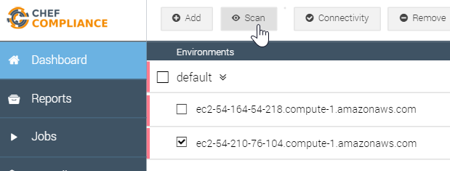
GE: Re-run the Compliance Scan
Return to the Compliance Web UI and re-run the scan on your target node.
Be sure to run only the base/ssh scan as shown on the next slide.

Slide 134
Re-run the Compliance Scan
Return to the Compliance Web UI and re-run the scan on your target node.
Be sure to run only the base/ssh scan as shown on the next slide.

Slide 135
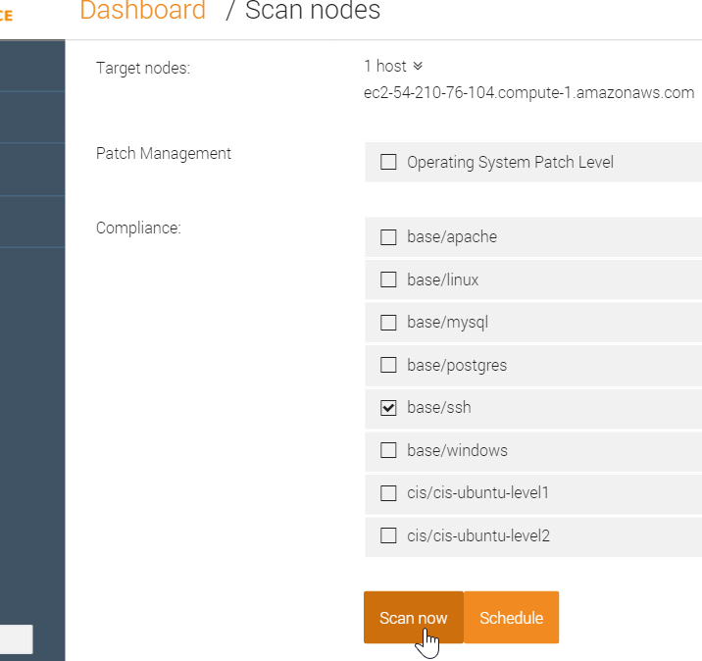
GE: Re-run the Compliance Scan
Run only the base/ssh scan.

Slide 136
Re-run the Compliance Scan
Run only the base/ssh scan.

Slide 137
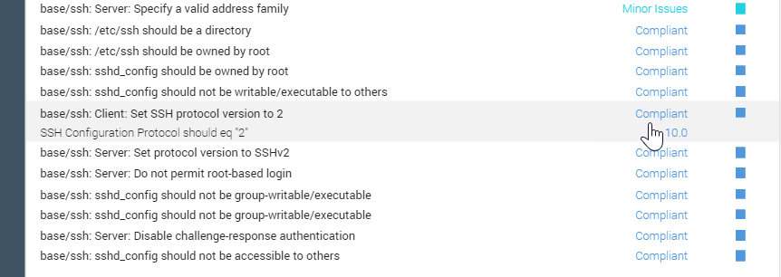
GE: Results of this Exercise
Your scan should show that the ssh protocol issue is now complaint.

Slide 138
Results of this Exercise
Your scan should show that the ssh protocol issue is now complaint.

Slide 139
Conclusion
Log into your target node.
Write a remediation recipe on that node.
Test the recipe with Test Kitchen.
Test for compliance with InSpec from the CLI
Rescan the node and ensure compliance.
Notes:
In this module we scanned a node for compliance issues. We identified an issue and then wrote a remediation recipe directly on the node scanned. We also tested our recipe with test kitchen.
As mentioned previously, in a production environment, you will likely write such recipes locally, add them to the node's run list, and then upload them to Chef Server.
Then the nodes would download the recipes from Chef Server on their next chef-client run and also convergence the recipes.

Slide 140
i believe so. that's how i have it running, i've also been running a reconfigure and restart after i upgrade the package
​[9:04 AM]
steve_delfante `sudo chef-compliance-ctl reconfigure` will reconfigure it but s=does that also restart it?
new messages
​[9:04 AM]
kennon not always, you should also run `sudo chef-compliance-ctl restart

Slide 141
Review Questions
What is ...? ______________________________
Which is the correct answer?
answer
answer
answer
answer
Capable of carrying on a conversation
Explain

Slide 142
©2016 Chef Software Inc.

Slide 143
Creating Custom Profiles
Defining and Uploading Compliance Profiles to the Compliance Server

Slide 144
Objectives
After completing this module, you should be able to:
Write a custom compliance profile.
Use InSpec to test your code and your custom profile.
Upload a custom compliance profile to your Chef Compliance server.
Test your custom profile.

Slide 145
Creating a Custom Profile
In this section we will create a custom compliance profile.
Custom profiles are created using InSpec, just like the existing profiles were created.
After you have created a custom profile, you'll learn how to upload it to a Compliance Server and then use it to check for compliance issues.

Slide 146
InSpec Command Line Interface
In this section we will use the InSpec command line interface (CLI) to run audit tests against targets.
The InSpec CLI can run audit tests against targets using SSH, WinRM, locally, or on Docker containers.
We'll be using `inspec check` and `inspec exec`.
`inspec check` just verifies the code--it doesn't actually test a system.
`inspec exec' will run the tests against a system.

Slide 147
GE: Creating a Custom Profile
Creating custom profiles to fit your business needs.
Create a custom profile.
Test your profile with InSpec
Notes:
The custom profile you will create will scan nodes to ensure they have a '/tmp' directory and that directory should be owned by the root user.
Note: In the workplace you would likely perform these custom profile tasks on your local workstation and upload them to the Compliance Server. In this class we'll use our target nodes as a workstation to create the profile on since they already have Chef installed on them. Then we'll ultimately upload the customer profile to your Compliance Server.

Slide 148
Creating a Custom Profile
Creating custom profiles to fit your business needs.
Create a custom profile.
Test your profile with InSpec
Notes:
The custom profile you will create will scan nodes to ensure they have a '/tmp' directory and that directory should be owned by the root user.
Note: In the workplace you would likely perform these custom profile tasks on your local workstation and upload them to the Compliance Server. In this class we'll use our target nodes as a workstation to create the profile on since they already have Chef installed on them. Then we'll ultimately upload the customer profile to your Compliance Server.

Slide 149
GE: Create and change to a directory for your profile
$ mkdir -p ~/compliance_profiles/profile_01
$ cd ~/compliance_profiles/profile_01
Notes:
On your target node, create a directory for your profiles and the move into that new directory.
$ `mkdir -p ~/compliance_profiles/profile_01`
$ `cd ~/compliance_profiles/profile_01'
Reminder: In the workplace you would likely perform this task TBD

Slide 150
Create and change to a directory for your profile
$ mkdir -p ~/compliance_profiles/USERNAME
$ cd ~/compliance_profiles/USERNAME
Notes:
Pop-up: We are all using the same Compliance Server so create the profile in a directory named after the learner’s USERNAME.
On your target node, create a directory for your profiles and the move into that new directory.
$ `mkdir -p ~/compliance_profiles/USERNAME`
$ `cd ~/compliance_profiles/USERNAME'
Reminder: In the workplace you would likely perform this task TBD

Slide 151
GE: Run `inspec check` to Verify Tests
$ inspec check ~/compliance_profiles/profile_01
E, [2015-12-11T20:14:28.196462 #15754] ERROR -- : Can't find metadata file /home/chef/compliance_profiles/profile_01/metadata.rb
/opt/chefdk/embedded/lib/ruby/gems/2.1.0/gems/inspec-0.9.2/lib/inspec/targets/folder.rb:23:in `resolve': Don't know how to handle folder /home/chef/compliance_profiles/profile_01 (RuntimeError)
Notes:
`inspec check` is used to verify all tests at the specified path. (https://docs.chef.io/ctl_inspec.html)
Run 'inspec check' against the new directory.
$ `inspec check /home/chef/compliance_profiles/profile_01'
Notice that InSpec can't find the metadata.rb that it expects to find.

Slide 152
Run `inspec check` to Verify Tests
$ inspec check ~/compliance_profiles/USERNAME
E, [2015-12-11T20:14:28.196462 #15754] ERROR -- : Can't find metadata file /home/chef/compliance_profiles/USERNAME/metadata.rb
/opt/chefdk/embedded/lib/ruby/gems/2.1.0/gems/inspec-0.9.2/lib/inspec/targets/folder.rb:23:in `resolve': Don't know how to handle folder /home/chef/compliance_profiles/USERNAME (RuntimeError)
Notes:
`inspec check` is used to verify all tests at the specified path. (https://docs.chef.io/ctl_inspec.html)
Run 'inspec check' against the new directory.
$ `inspec check /home/chef/compliance_profiles/USERNAME'
Notice that InSpec can't find the metadata.rb that it expects to find.

Slide 153
GE: Creating a metadata.rb via `touch`
$ touch metadata.rb
$ ls
metadata.rb
Notes:
So let's fix the missing metadata.rb issue. (TBD - did we change metadata file name?)
From within ~/compliance_profiles, let's create a metadata.rb by using the `touch` command.
$ `touch metadata.rb`
You can also `ls` to see that the metadata.rb is now there.

Slide 154
Create a metadata.rb via `touch`
$ touch metadata.rb
$ ls
metadata.rb
Notes:
So let's fix the missing metadata.rb issue. (TBD - did we change metadata file name?)
From within ~/compliance_profiles, let's create a metadata.rb by using the `touch` command.
$ `touch metadata.rb`
You can also `ls` to see that the metadata.rb is now there.

Slide 155
GE: Run `inspec check` Against the New File
$ inspec check ~/compliance_profiles/profile_01
I, [2015-12-11T20:18:18.145021 #15801] INFO -- : Checking profile in /home/chef/compliance_profiles/profile_01
E, [2015-12-11T20:18:18.145182 #15801] ERROR -- : No profile name defined
W, [2015-12-11T20:18:18.145238 #15801] WARN -- : No version defined
W, [2015-12-11T20:18:18.145283 #15801] WARN -- : No title defined
W, [2015-12-11T20:18:18.145326 #15801] WARN -- : No maintainer defined
/opt/chefdk/embedded/lib/ruby/gems/2.1.0/gems/inspec-0.9.2/lib/inspec/profile.rb:104:in `check': undefined method `empty?' for nil:NilClass (NoMethodError)
Notes:
Run `inspec check /home/chef/compliance_profiles/profile_01'.
Now `inspec check` can find the expected metadata.rb.
But notice how 'inspec check' can't find the expected profile name, version, title, or maintainer values it expected to find in a metadata.rb.

Slide 156
Run `inspec check` Against the New File
$ inspec check ~/compliance_profiles/USERNAME
I, [2015-12-11T20:18:18.145021 #15801] INFO -- : Checking profile in /home/chef/compliance_profiles/USERNAME
E, [2015-12-11T20:18:18.145182 #15801] ERROR -- : No profile name defined
W, [2015-12-11T20:18:18.145238 #15801] WARN -- : No version defined
W, [2015-12-11T20:18:18.145283 #15801] WARN -- : No title defined
W, [2015-12-11T20:18:18.145326 #15801] WARN -- : No maintainer defined
/opt/chefdk/embedded/lib/ruby/gems/2.1.0/gems/inspec-0.9.2/lib/inspec/profile.rb:104:in `check': undefined method `empty?' for nil:NilClass (NoMethodError)
Notes:
Run `inspec check /home/chef/compliance_profiles/USERNAME'.
Now `inspec check` can find the expected metadata.rb.
But notice how 'inspec check' can't find the expected profile name, version, title, or maintainer values it expected to find in a metadata.rb.

Slide 157
GE: Add Values to the metadata.rb
~/compliance_profiles/profile_01/metadata.rb
name 'myname/profile'
version '0.1.0'
title 'MyName Profile'
maintainer 'My Name'
Notes:
So let's fix the missing profile name, version, title, and maintainer values that the `inspec check` expected to find in a metadata.rb.
Ensure that you define the 'name' line exactly as shown in the example above so you can later see how it is used by the Compliance Server.
You can use your own name in the `title` line and the `maintainer` line of you like.
Note: In the workplace you may want to make the name 'myname/profile' value more descriptive so it will be unique. For example:
name 'myname/XYZprofile'. This is because the 'myname" portion will be substituted by the user name you are using when you upload such a profile to the Compliance Server. For example, if you log into the Compliance Server as `admin`, then all profiles uploaded using the `myname` namespace will have `admin` in place of 'myname'.

Slide 158
Add Values to the metadata.rb
~/compliance_profiles/USERNAME/metadata.rb
name 'USERNAME/profile'
version '0.1.0'
title 'USERNAME Profile'
maintainer 'My Name'
Notes:
So let's fix the missing profile name, version, title, and maintainer values that the `inspec check` expected to find in a metadata.rb.
Ensure that you define the 'name' line exactly as shown in the example above so you can later see how it is used by the Compliance Server.
You can use your own name in the `title` line and the `maintainer` line of you like.
Note: In the workplace you may want to make the name 'myname/profile' value more descriptive so it will be unique. For example:
name 'myname/XYZprofile'. This is because the 'myname" portion will be substituted by the user name you are using when you upload such a profile to the Compliance Server. For example, if you log into the Compliance Server as `admin`, then all profiles uploaded using the `myname` namespace will have `admin` in place of 'myname'.

Slide 159
GE: Run `inspec check` Again
$ inspec check ~/compliance_profiles/profile_01
/home/chef/compliance_profiles/profile_01/metadata.rb:1:in `load': undefined method `name' for #<#<Class:0x00000002b177e8>:0x00000002b175e0> (NoMethodError)
from /opt/chefdk/embedded/lib/ruby/gems/2.1.0/gems/inspec-0.9.2/lib/inspec/profile_context.rb:31:in `instance_eval'
from /opt/chefdk/embedded/lib/ruby/gems/2.1.0/gems/inspec-0.9.2/lib/inspec/profile_context.rb:31:in `load'
Notes:
Now run `$ inspec check ~/compliance_profiles/profile_01'.
Why are we getting an error?

Slide 160
Run `inspec check` Again
$ inspec check ~/compliance_profiles/USERNAME
/home/chef/compliance_profiles/USERNAME/metadata.rb:1:in `load': undefined method `name' for #<#<Class:0x00000002b177e8>:0x00000002b175e0> (NoMethodError)
from /opt/chefdk/embedded/lib/ruby/gems/2.1.0/gems/inspec-0.9.2/lib/inspec/profile_context.rb:31:in `instance_eval'
from /opt/chefdk/embedded/lib/ruby/gems/2.1.0/gems/inspec-0.9.2/lib/inspec/profile_context.rb:31:in `load'
Notes:
Now run `$ inspec check ~/compliance_profiles/USERNAME'.
Why are we getting an error?

Slide 161
GE: InSpec Directory Structure Expectation
As you write controls, InSpec expects a specific directory structure. In our case, we need a `test` directory to be in our profile as follows:
├── README.md ├── metadata.rb └── test ├── foo_spec.rb └── bar_spec.rb
https://chefio.atlassian.net/wiki/pages/viewpage.action?spaceKey=SE&title=Week+1#Week1-Addingprofiles
Notes:
The answer is, as you write controls, InSpec expects a `test` directory at the same level as the metadata.rb.
├── README.md ├── metadata.rb └── test ├── foo_spec.rb └── bar_spec.rb

Slide 162
GE: InSpec Directory Structure Expectation
As you write controls, InSpec expects a specific directory structure. In our case, we need a `test` directory to be in our profile as follows:
├── README.md ├── metadata.rb └── test ├── foo_spec.rb └── bar_spec.rb
https://chefio.atlassian.net/wiki/pages/viewpage.action?spaceKey=SE&title=Week+1#Week1-Addingprofiles
Notes:
The answer is, as you write controls, InSpec expects a `test` directory at the same level as the metadata.rb.
├── README.md ├── metadata.rb └── test ├── foo_spec.rb └── bar_spec.rb

Slide 163
InSpec Directory Structure Expectation
As you write controls, InSpec expects a specific directory structure. In our case, we need a `test` directory to be in our profile as follows:
├── README.md ├── metadata.rb └── test ├── foo_spec.rb └── bar_spec.rb
Notes:
Pop-up: Do not include the internal wiki page
The answer is, as you write controls, InSpec expects a `test` directory at the same level as the metadata.rb.
├── README.md ├── metadata.rb └── test ├── foo_spec.rb └── bar_spec.rb

Slide 164
GE: Create the Missing `test` Directory
$ mkdir -p ~/compliance_profiles/profile_01/test
$ ls -l
total 8
-rw-rw-r-- 1 chef chef 82 Dec 11 20:25 metadata.rb
drwxrwxr-x 2 chef chef 4096 Dec 11 20:36 test
Notes:
Create the missing `test` directory by running `mkdir -p ~/compliance_profiles/profile_01/test'
Then use `ls -l` to confirm its creation.
TBD- a. will there be a 'generate profile` command?

Slide 165
Create the Missing `test` Directory
$ mkdir -p ~/compliance_profiles/USERNAME/test
$ ls -l
total 8
-rw-rw-r-- 1 chef chef 82 Dec 11 20:25 metadata.rb
drwxrwxr-x 2 chef chef 4096 Dec 11 20:36 test
Notes:
Create the missing `test` directory by running `mkdir -p ~/compliance_profiles/USERNAME/test'
Then use `ls -l` to confirm its creation.
TBD- a. will there be a 'generate profile` command?

Slide 166
GE: Run `inspec check` Again
$ inspec check ~/compliance_profiles/profile_01
I, [2015-12-11T20:40:32.950800 #15852] INFO -- : Checking profile in /home/chef/compliance_profiles/profile_01
I, [2015-12-11T20:40:32.951063 #15852] INFO -- : Metadata OK.
D, [2015-12-11T20:40:32.951155 #15852] DEBUG -- : Found 14 rules.
I, [2015-12-11T20:40:32.951234 #15852] INFO -- : Rule definitions OK.
Notes:
Now run `$ inspec check ~/compliance_profiles/profile_01' again. You should no longer see the errors you saw previously.

Slide 167
Run `inspec check` Again
$ inspec check ~/compliance_profiles/USERNAME
I, [2015-12-11T20:40:32.950800 #15852] INFO -- : Checking profile in /home/chef/compliance_profiles/USERNAME
I, [2015-12-11T20:40:32.951063 #15852] INFO -- : Metadata OK.
D, [2015-12-11T20:40:32.951155 #15852] DEBUG -- : Found 14 rules.
I, [2015-12-11T20:40:32.951234 #15852] INFO -- : Rule definitions OK.
Notes:
Now run `$ inspec check ~/compliance_profiles/USERNAME' again. You should no longer see the errors you saw previously.

Slide 168
GE: Write the Control Called tmp.rb
~/compliance_profiles/profile_01/test/tmp.rb
title '/tmp profile'
control "tmp-1.0" do
impact 0.3
title "Create /tmp directory"
desc "A /tmp directory must exist"
describe file('/tmp') do
it { should be_directory }
end
end
control "tmp-1.1" do
impact 0.3
title "/tmp directory is owned by the root user"
desc "The /tmp directory must be owned by the root user"
describe file('/tmp') do
it { should be_owned_by 'root' }
end
end
Notes:
Create the ~/compliance_profiles/profile_01/test/tmp.rb file with the control shown here. We've pasted the code below so you can see it better.
title '/tmp profile'
control "tmp-1.0" do
impact 0.3
title "Create /tmp directory"
desc "A /tmp directory must exist"
describe file('/tmp') do
it { should be_directory }
end
end
control "tmp-1.1" do
impact 0.3
title "/tmp directory is owned by the root user"
desc "The /tmp directory must be owned by the root user"
describe file('/tmp') do
it { should be_owned_by 'root' }
end
end

Slide 169
Write the Control Called tmp.rb
~/compliance_profiles/USERNAME/test/tmp.rb
title 'USERNAME /tmp profile'
control "tmp-1.0" do
impact 0.3
title "Create /tmp directory"
desc "A /tmp directory must exist"
describe file('/tmp') do
it { should be_directory }
end
end
control "tmp-1.1" do
impact 0.3
title "/tmp directory is owned by the root user"
desc "The /tmp directory must be owned by the root user"
describe file('/tmp') do
it { should be_owned_by 'root' }
end
end
Notes:
Pop-up – include the USERNAME in the title
Create the ~/compliance_profiles/USERNAME/test/tmp.rb file with the control shown here. We've pasted the code below so you can see it better.
title ’USERNAME /tmp profile'
control "tmp-1.0" do
impact 0.3
title "Create /tmp directory"
desc "A /tmp directory must exist"
describe file('/tmp') do
it { should be_directory }
end
end
control "tmp-1.1" do
impact 0.3
title "/tmp directory is owned by the root user"
desc "The /tmp directory must be owned by the root user"
describe file('/tmp') do
it { should be_owned_by 'root' }
end
end

Slide 170
GE: Run `inspec check` Again
$ inspec check ~/compliance_profiles/profile_01
I, [2015-12-11T22:53:24.912307 #16092] INFO -- : Checking profile in /home/chef/compliance_profiles/profile_01/
I, [2015-12-11T22:53:24.912498 #16092] INFO -- : Metadata OK.
D, [2015-12-11T22:53:24.912570 #16092] DEBUG -- : Found 14 rules.
D, [2015-12-11T22:53:24.912617 #16092] DEBUG -- : Verify all rules in /home/chef/compliance_profiles/profile_01/test/tmp.rb
Notes:
Now run `inspec check ~/compliance_profiles/profile_01' again. You should see the new tmp/rb files was verified.

Slide 171
Run `inspec check` Again
$ inspec check ~/compliance_profiles/USERNAME
I, [2015-12-11T22:53:24.912307 #16092] INFO -- : Checking profile in /home/chef/compliance_profiles/USERNAME/
I, [2015-12-11T22:53:24.912498 #16092] INFO -- : Metadata OK.
D, [2015-12-11T22:53:24.912570 #16092] DEBUG -- : Found 14 rules.
D, [2015-12-11T22:53:24.912617 #16092] DEBUG -- : Verify all rules in /home/chef/compliance_profiles/USERNAME/test/tmp.rb
Notes:
Now run `inspec check ~/compliance_profiles/USERNAME' again. You should see the new tmp/rb files was verified.

Slide 172
GE: Use `inspec exec' to Run Tests
$ inspec exec ~/compliance_profiles/profile_01
..
Finished in 0.03994 seconds (files took 0.4762 seconds to load)
2 examples, 0 failures
Notes:
`inspec exec` is used to run all tests at the specified path.
run `inspec exec ~/compliance_profiles/profile_01'. The test should be successful, showing no failures.

Slide 173
Use `inspec exec` to Run Tests
$ inspec exec ~/compliance_profiles/USERNAME
..
Finished in 0.03994 seconds (files took 0.4762 seconds to load)
2 examples, 0 failures
Notes:
`inspec exec` is used to run all tests at the specified path.
run `inspec exec ~/compliance_profiles/USERNAME'. The test should be successful, showing no failures.

Slide 174
GE: Uploading the Custom Profile to the Compliance Server
Uploading it so it can be used in scans..
Zip up the new profile.
Download it to your laptop.
Upload it to the Compliance Server.
Notes:
In addition to the uploading procedure we'll do in the exercise, in the workplace you could also upload such custom profiles using an API.

Slide 175
Uploading the Custom Profile to the Compliance Server
Uploading it so it can be used in scans..
Zip up the new profile.
Download it to your laptop.
Upload it to the Compliance Server.
Notes:
In addition to the uploading procedure we'll do in the exercise, in the workplace you could also upload such custom profiles using an API.

Slide 176
GE: Install the zip Package
$ sudo chef-apply -e "package 'zip'"
Recipe: (chef-apply cookbook)::(chef-apply recipe)
* yum_package[zip] action install
- install version 3.0-1.el6_7.1 of package zip
Notes:
Pop-up: zip is already installed
Your node may not have the zip package installed so let's use Chef to do that now.

Slide 177
GE: Zip up your New Profile
$ cd ~/compliance_profiles
$ zip -r profile_01.zip profile_01
adding: profile_01/ (stored 0%)
adding: profile_01/metadata.rb (deflated 17%)
adding: profile_01/test/ (stored 0%)
adding: profile_01/test/tmp.rb (deflated 54%)
Notes:
Move to ~/compliance_profiles and then run `zip -r profile_01.zip profile_01`.

Slide 178
Zip up your New Profile
$ cd ~/compliance_profiles
$ zip -r USERNAME.zip USERNAME
adding: USERNAME/ (stored 0%)
adding: USERNAME/test/ (stored 0%)
adding: USERNAME/test/tmp.rb (deflated 53%)
adding: USERNAME/metadata.rb (deflated 21%)
Notes:
Move to ~/compliance_profiles and then run `zip -r USERNAME.zip USERNAME`.

Slide 179
GE: Verify the zip File's Creation
$ ls -l
total 8
drwxrwxr-x 3 chef chef 4096 Dec 14 16:45 profile_01
-rw-rw-r-- 1 chef chef 937 Dec 14 16:50 profile_01.zip
Notes:
Type `ls -l` to verify the new zip file's creation.

Slide 180
Verify the zip File's Creation
$ ls -l
total 8
drwxrwxr-x 3 chef chef 4096 Dec 14 16:45 USERNAME
-rw-rw-r-- 1 chef chef 937 Dec 14 16:50 USERNAME.zip
Notes:
Type `ls -l` to verify the new zip file's creation.

Slide 181
GE: From your Laptop Run the scp Command
C:\tmp>scp chef@52.90.148.31:~/compliance_profiles/profile_01.zip .
The authenticity of host '52.90.148.31 (52.90.148.31)' can't be established.
RSA key fingerprint is a5:c3:31:5a:ce:4d:a8:17:46:ac:47:17:60:fc:26:17.
Are you sure you want to continue connecting (yes/no)? yes
Warning: Permanently added '52.90.148.31' (RSA) to the list of known hosts.
chef@52.90.148.31's password:
profile_01.zip 100% 937 0.9KB/s 00:00
Notes:
Important: Be sure to run this command from your laptop. You can first move to whatever directory on your laptop that you like.
In this Windows example, the user created and moved to the C:\tmp location and then ran the above command. The IP address after the `chef@` is the IP address of the target node where the profile_01.zip was created.
Instructor Note: Not sure if it was my laptop settings, but I could not see the zip file when I scp'd it directly to my C: drive. I had to create the C:\tmp dir first then download to there.

Slide 182
From your Laptop Run the scp Command
C:\tmp>scp chef@52.90.148.31:~/compliance_profiles/USERNAME.zip .
The authenticity of host '52.90.148.31 (52.90.148.31)' can't be established.
RSA key fingerprint is a5:c3:31:5a:ce:4d:a8:17:46:ac:47:17:60:fc:26:17.
Are you sure you want to continue connecting (yes/no)? yes
Warning: Permanently added '52.90.148.31' (RSA) to the list of known hosts.
chef@52.90.148.31's password:
USERNAME.zip 100% 937 0.9KB/s 00:00
Notes:
Important: Be sure to run this command from your laptop. You can first move to whatever directory on your laptop that you like.
In this Windows example, the user created and moved to the C:\tmp location and then ran the above command. The IP address after the `chef@` is the IP address of the target node where the USERNAME.zip was created.
Instructor Note: Not sure if it was my laptop settings, but I could not see the zip file when I scp'd it directly to my C: drive. I had to create the C:\tmp dir first then download to there.

Slide 183
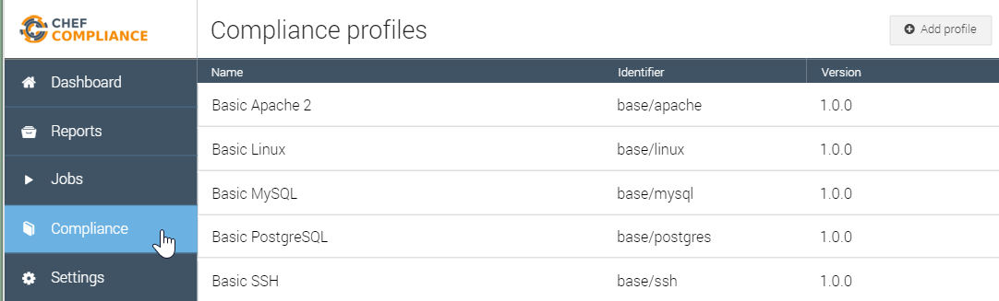
GE: Upload the Profile to Chef Compliance
From your Compliance Server Dashboard: Click the Compliance button and then click the Add Profile button.

Slide 184
Upload the Profile to Chef Compliance
From your Compliance Server Dashboard: Click the Compliance button and then click the Add Profile button.

Slide 185
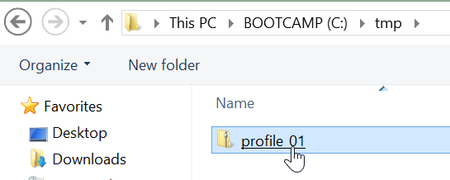
GE: Upload the Profile to Chef Compliance
Select the zip file from your laptop.

Slide 186
Upload the Profile to Chef Compliance
Select the zip file from your laptop.

Slide 187
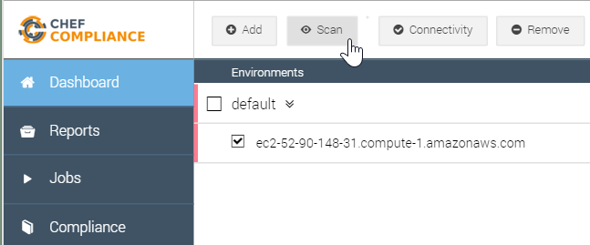
GE: Scan Your Node
From the Dashboard, select your node and then click the Scan button.

Slide 188
Scan Your Node
From the Dashboard, select your node and then click the Scan button.

Slide 189
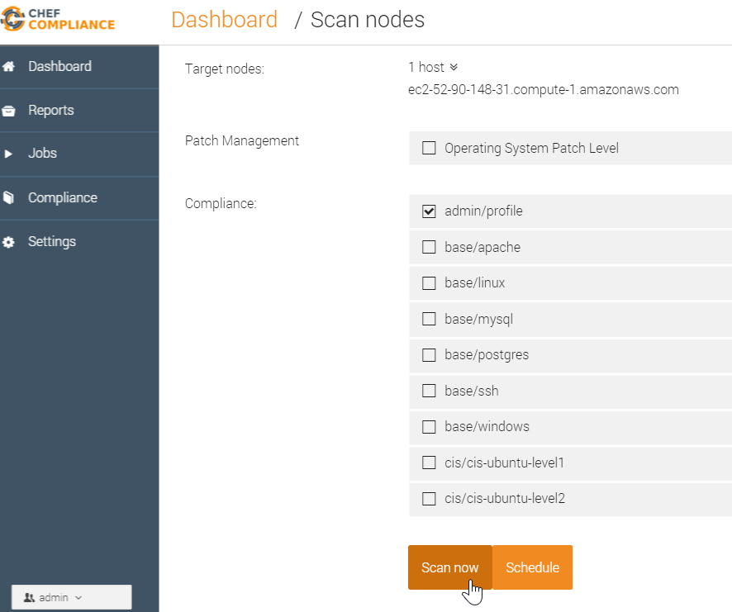
GE: Scan Using the New Profile
From the resulting page, select only the new profile (admin/profile) and then click Scan now.
Note: The profile name in this view is based on the name space in your metadata.rb.
For example: 'myname/profile'
Notes:
Since you are logged into the Chef Compliance UI as 'admin', your profile is called 'admin/profile' on the 'Scan nodes' page.
Instructor Note: Regarding this note above--`Note: The profile name in this view is based on the name space in your metadata.rb.`--the compliance team may have improved that Compliance profile name field on the "Scan nodes" page by now to include whatever is the `title` value from the metadata.rb. Therefore it would match the name as displayed in the Compliance profiles page.

Slide 190
Scan Using the New Profile
From the resulting page, select only the new profile (USERNAME/profile) and then click Scan now.
Note: The profile name in this view is based on the name space in your metadata.rb.
For example: ’USERNAME/profile'
Notes:
Since you are logged into the Chef Compliance UI as 'admin', your profile is called 'admin/profile' on the 'Scan nodes' page.
Instructor Note: Regarding this note above--`Note: The profile name in this view is based on the name space in your metadata.rb.`--the compliance team may have improved that Compliance profile name field on the "Scan nodes" page by now to include whatever is the `title` value from the metadata.rb. Therefore it would match the name as displayed in the Compliance profiles page.

Slide 191
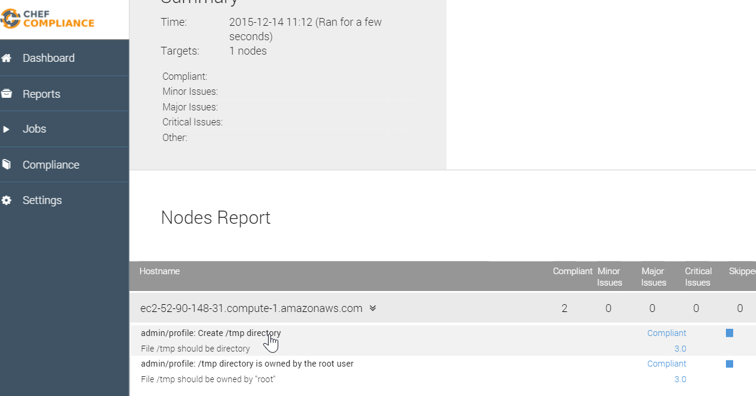
GE: Results of the Custom Profile Scan
The results of your scan should look like this example.
The scan should show compliance as well.

Slide 192
Results of the Custom Profile Scan
The results of your scan should look like this example.
The scan should show compliance as well.

Slide 193
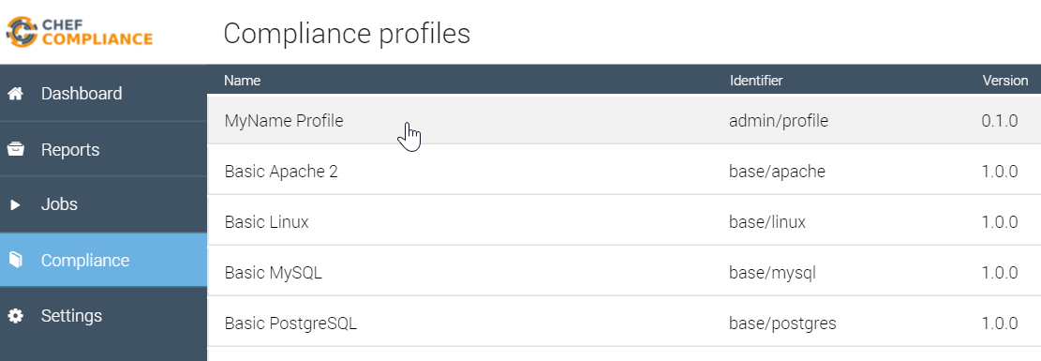
GE: Results of the Custom Profile Scan
You should also be able to see your custom profile from your Compliance page.

Slide 194
Results of the Custom Profile Scan
You should also be able to see your custom profile from your Compliance page.

Slide 195
GE: TBD from here to end
Show how this is populated by /rb file - see next slide
TBD- Show side by side metadata and Compl UI profile name to illustrate how the name field is populated.
Notes:
TBD: now do lab for windows too.

Slide 196
Create /tmp directoryMinor (score: 3.0)
/tmp directory is owned by the root userMinor (score: 3.0)
The /tmp directory must be owned by the root user
control "tmp-1.1" do impact 0.3 title "/tmp directory is owned by the root user"
desc "The /tmp directory must be owned by the root user"
describe file('/tmp') do it { should be_owned_by 'root' }

Slide 197
GE: Save this
https://github.com/chef/inspec/blob/7f555b902d6860ffe236ff23e4b52f20bac28adc/lib/inspec/profile.rb#L81-L129
and Check uses the above from here: https://github.com/chef/inspec/blob/b1ec95e343aac75ee1a21e3d1a09a32a5a8c1dd2/bin/inspec#L70-L78
https://chefio.atlassian.net/wiki/pages/viewpage.action?spaceKey=SE&title=Week+1#Week1-Addingprofiles
Notes:
https://github.com/chef/inspec/blob/7f555b902d6860ffe236ff23e4b52f20bac28adc/lib/inspec/profile.rb#L81-L129
So your cookbooks will have a metadata.rb.
And your
Adding profiles
Compliance profiles must be packaged in to a .tar.gz or .zip file to be uploaded to the Compliance Server.
The directory structure is as follows (note, this is subject to change. TODO: link to official docs when avaialble):
xyz.zip:
. ├── README.md ├── metadata.rb └── test ├── foo_spec.rb └── bar_spec.rb
As you write controls, InSpec requires a `test` directory since it InSpec expect this structure.

Slide 198
TBD delete later.
As you write controls, InSpec expects a specific directory structure. In our case, we need a `test` directory to be in our profile as follows:
├── README.md ├── metadata.rb └── test ├── foo_spec.rb └── bar_spec.rb
https://chefio.atlassian.net/wiki/pages/viewpage.action?spaceKey=SE&title=Week+1#Week1-Addingprofiles
Notes:
The answer is, as you write controls, InSpec expects a `test` directory at the same level as the metadata.rb.
├── README.md ├── metadata.rb └── test ├── foo_spec.rb └── bar_spec.rb
https://github.com/chef/inspec/blob/7f555b902d6860ffe236ff23e4b52f20bac28adc/lib/inspec/profile.rb#L81-L129
Adding profiles
Compliance profiles must be packaged in to a .tar.gz or .zip file to be uploaded to the Compliance Server.
The directory structure is as follows (note, this is subject to change. TODO: link to official docs when availalble):
xyz.zip:
. ├── README.md ├── metadata.rb └── test ├── foo_spec.rb └── bar_spec.rb
As you write controls, InSpec requires a `test` directory since it InSpec expect this structure.

Slide 199
Review Questions
What is ...? ______________________________
Which is the correct answer?
answer
answer
answer
answer
Capable of carrying on a conversation
Explain

Slide 200
©2016 Chef Software Inc.

Slide 201
Scheduling Scans and Running Reports
Scheduling Scans for Future Reporting

Slide 202
Objectives
After completing this module, you should be able to:
Schedule scans.
View pending jobs.
View and export reports.

Slide 203
Scheduling Scans
You can schedule scans to run at a later time.
Running a scheduled compliance scan on your infrastructure, say every night, could give you up-to-date compliance information on a daily basis.
In this way, any changes to your infrastructure that may have put some nodes out of compliance can be routinely identified.

Slide 204
Scheduling Scans
The time zone for "Date" scheduling in the Compliance web UI is based on your local workstation's browser time zone.
The time zone for "Recurring" scheduling in the Compliance web UI is based on UTC. (Coordinated Universal Time, which equals GMT.)
The Compliance logs, should you view them, are also based on UTC.
Notes:
This time distinction is important when scheduling scans or if viewing the compliance logs.
Instructor Note: As of this writing this slide is correct but it could be subject to change. Also, here is the `tail` command in case you want to demonstrate the logs as you set a scheduled scan: `sudo tail -f /var/log/chef-compliance/core/current`/
TBD: Demo this via a slide.

Slide 205
GE: Scheduling Scans
Schedule a scan.
View the scan output.
TBD tail the log file when the scheduled scan runs.

Slide 206
Group Exercise: Scheduling Scans
Schedule a scan.
View the scan output.

Slide 207
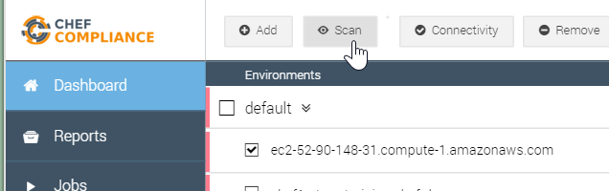
GE: Scheduling Scans
1. Open the Compliance web UI's Dashboard page.
2. Select one of your target nodes.
3. Click Scan.

Slide 208
Scheduling Scans
1. Open the Compliance web UI's Dashboard page.
2. Select one of your target nodes.
3. Click Scan.

Slide 209
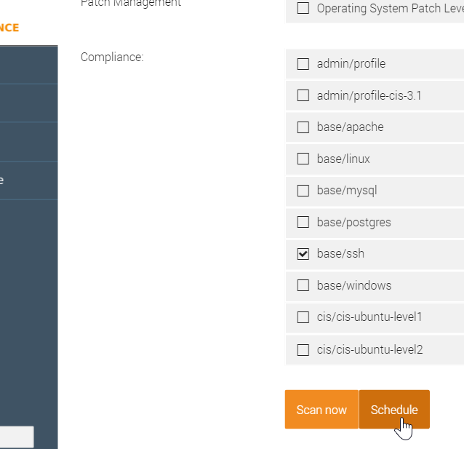
GE: Scheduling Scans
4. Deselect all profiles.
5. Select the base/ssh profile for a Linux node or the base/windows profile for a Windows node
6. Click the Schedule button.

Slide 210
Scheduling Scans
4. Deselect all profiles.
5. Select the base/ssh profile
6. Click the Schedule button.
Notes:
Pop-up – No windows

Slide 211
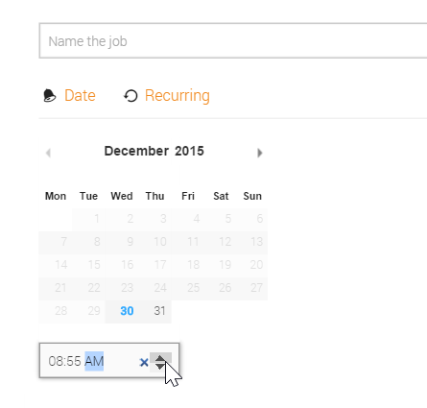
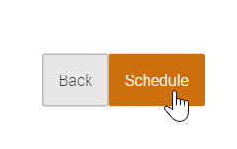
GE: Scheduling Scans
7. Type a name for this scan in the Name the job field.
8. Click the up arrow and set the scheduled time to 5 minutes from now and then click Schedule.
Note: The up/down arrows are also used to set the AM and PM value.

Slide 212
Scheduling Scans
7. Type a name for this scan in the Name the job field.
8. Click the up arrow and set the scheduled time to 5 minutes from now and then click Schedule.
Note: The up/down arrows are also used to set the AM and PM value.

Slide 213
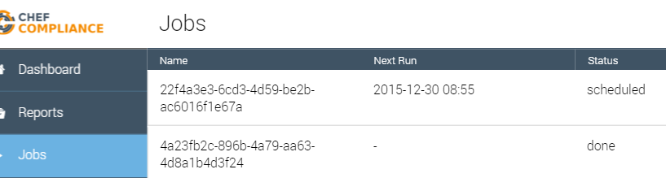
GE: Scheduling Scans
Click the Jobs tab and you should see your scheduled scan's details such as its Next Run time and its "scheduled" status.

Slide 214
Scheduling Scans
Click the Jobs tab and you should see your scheduled scan's details such as its Next Run time and its "scheduled" status.

Slide 215
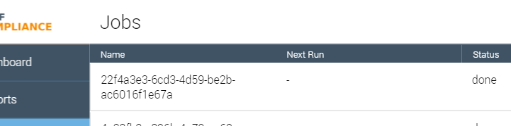
GE: Scheduling Scans
When 5 minutes have elapsed, refresh your browser and you should see that your Job's status is now "done".
Note: If you like you could click that job to see its original details that you set when you scheduled it.
Notes:
TBD Delete button after click.

Slide 216
Scheduling Scans
When 5 minutes have elapsed, refresh your browser and you should see that your Job's status is now "done".
Note: If you like you could click that job to see its original details that you set when you scheduled it.
Notes:
TBD Delete button after click.

Slide 217
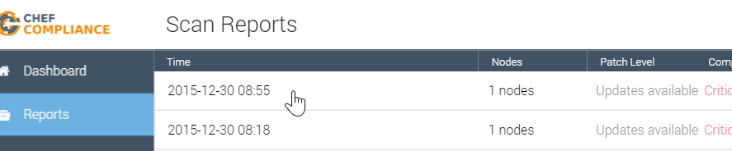
GE: Scheduling Scans
Click the Reports tab and then click the report from your scheduled scan.

Slide 218
GE: Scheduling Scans
Click the Reports tab and then click the report from your scheduled scan.

Slide 219
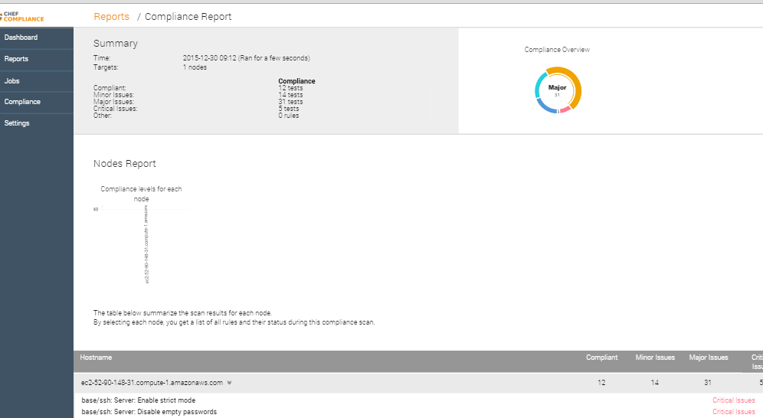
GE: Scheduling Scans
At this point you should be able to view the report from your scheduled scan.

Slide 220
Scheduling Scans
At this point you should be able to view the report from your scheduled scan.

Slide 221
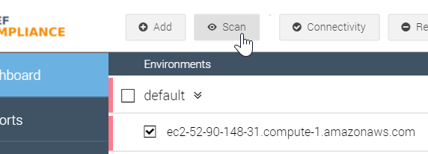
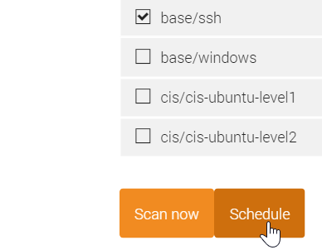
Demonstration: Recurring Scans
You can schedule recurring scans as well.
To do so, set up a scheduled scan like you just did...

Slide 222
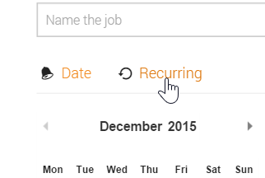
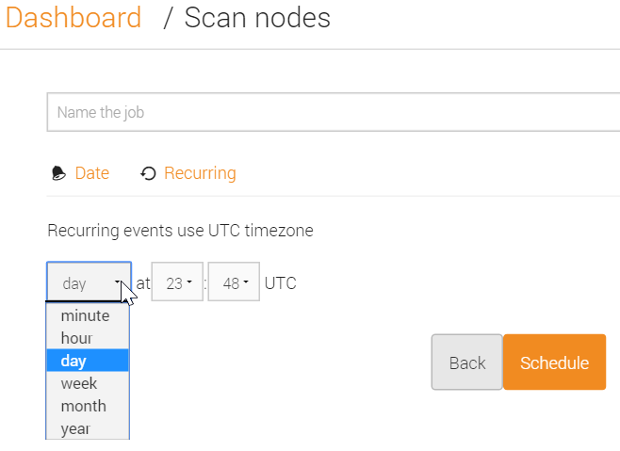
Demonstration: Recurring Scans
...but when you get to the page with the calendar (Scan nodes page), click the Recurring link and you'll be able to set the recurrence.
In this example the user is scheduling a scan to run every day at 23:48 UTC.

Slide 223
Demonstration: Scheduled Scan Logs
While not necessary, if you ever want to view the Compliance log files while you are scheduling or running a scan, keep in mind that log files use UTC time instead of your local browser time.
To tail those logs, from your Compliance Server you can run: `sudo tail -f /var/log/chef-compliance/core/current`
Notes:
Pop-up – don’t do anything directly on the compliance server
Instructor Note: As this slide indicates, tailing the log files is not required but can be of interest to some users. In one scenario where it came in handy, a browser session to the Compliance Server got stale and would not schedule a scan. After tailing the log files and realizing the scan was not even being scheduled, the user refreshed the Compliance Server web UI, logged in again, and the scan would properly schedule and run.
Instructor Note: If you find yourself ahead of schedule, you can spend some time demonstration the output of this log file as you perform a number of procedures via the Web UI.

Slide 224
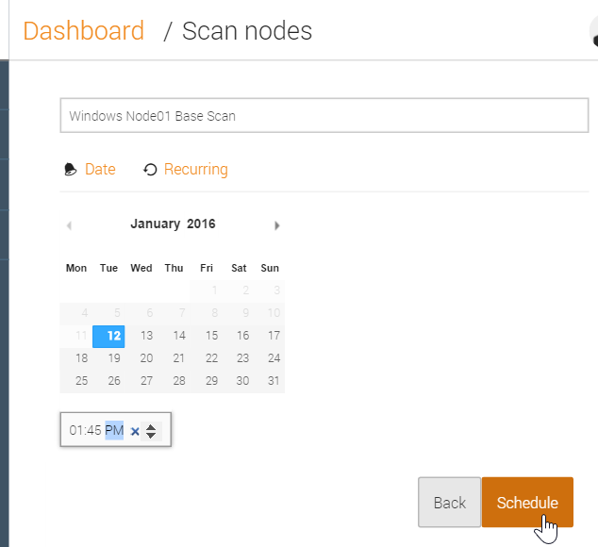
Demonstration: Scheduled Scan Logs
2016-01-12_21:41:16.82603 21:41:16.825 DEB => Add job: admin/2e48b32c-bd3b-4024-9d15-f3fc82537290 2016-01-12 21:45:00 +0000 UTC next: 2016-01-12 21:45:00 +0000 UTC
2016-01-12_21:41:16.83327 [GIN] 2016/01/12 - 21:41:16 | 200 | 9.475356ms | 50.170.125.99 | POST /owners/admin/jobs
2016-01-12_21:41:16.94064 [GIN] 2016/01/12 - 21:41:16 | 200 | 3.283171ms | 50.170.125.99 | GET /owners/admin/jobs
Notes:
Pop-up – Don’t do anything directly on the compliance server
The image on the left shows the user setting the next scheduled scan for 1:45 P.M. local browser time.
The image on the right shows the output of `sudo tail -f /var/log/chef-compliance/core/current` taken at the very same time that the scan was scheduled. Notice the log file timestamps are in UTC and the next schedule scan is set for UTC: 2016-01-12 21:45:00 +0000 UTC instead of the local browser time.

Slide 225
Deleting Old Jobs
The list of old scheduled jobs can grow so you can delete them if you no longer need them.
Notes:
Pop-up – don’t talk about deleting jobs

Slide 226


Demonstration: Deleting Jobs
To delete an old job, from the Jobs tab, click a job...
...and from the resulting page, click the Delete button.
Notes:
Pop-up – don’t talk about deleting jobs

Slide 227

Compliance Reports
The results of all of your scans are available via the Reports tab.
As of this writing, JSON-based exporting of reports is supported.
Notes:
TBD explain json exporting?

Slide 228

Compliance Reports
You can also export a compliance report as a PDF.
In the near future, Chef Compliance will also support exporting reports to Excel and sending to an email recipient.
Notes:
Instructor Note: This section is more of a placeholder for exporting Compliance reports after the email and Excel methods are ready for release.

Slide 229

GE: Exporting Reports
From the left column of the web UI, click Reports and then click any report that may exist.

Slide 230
Exporting Reports
From the left column of the web UI, click Reports and then click any report that may exist.

Slide 231


GE: Exporting Reports
Right-click on the report page and then click Print.
Ensure your print option is set to PDF and save and then click Save, thus saving to you local laptop.

Slide 232
Exporting Reports
Right-click on the report page and then click Print.
Ensure your print option is set to PDF and save and then click Save, thus saving to you local laptop.

Slide 233

GE: Exporting Reports
Your saved report should look similar to this example with the text properly aligned and formatted.

Slide 234
Exporting Reports
Your saved report should look similar to this example with the text properly aligned and formatted.

Slide 235
Scheduling Scans
SD: My internal notes below to be deleted.
TBD: Need to test PDF export on Mac.
Notes:
Hi Dominik....Is there a document that explains a use case for running scheduled scans?
​[9:31 AM]
dominik Not really right now :simple_smile: We have them included, but their functionality is still a bit limited in the UI. what are you interested in ?
​[9:32 AM]
steve_delfante I wrote a short lab on how to schedule scans and read the results but I gave no reason why someone would want to schedule a scan rather than do one on the fly.(edited)
​[9:33 AM]
dominik For example: Run a compliance scan every night on your whole infrastructure. Instead of pushing it off manually, you could ask chef compliance to do it for yoou
​[9:33 AM]
This would give you up to date information on a daily basis without interruptions in reporting.
​[9:33 AM]
steve_delfante OK, because nodes cold fall out of compliance due to updates others may have made throught the day?
​[9:34 AM]
dominik for example; or if you had changed your chef automation and something went wrong (because you didn’t use delivery to verify compiance of your changes)
​[9:35 AM]
or if any component was changed, that you didn’t yet explicitly manage through chef; for example: have telnet listen on tcp for some reason you didn’t expect; apart from uninstalling telnet through chef, we don’t tend to write cookbooks for negative cases :wink: so that’s a great example for compliance
​[9:36 AM]
steve_delfante Cool. thanks!
​[9:36 AM]
One more question for now please....
​[9:37 AM]
Is there going to be a way to export reports or do we only have people view results live?
​[9:37 AM]
dominik Yes there is; We are looking into exporting reports to PDF and (some type of) Excel format
​[9:38 AM]
There is also the alternative to retrieve reports via JSON api
​[9:38 AM]
we will have the PDF and Excel options in UI
​[9:38 AM]
steve_delfante Sounds good. Do you have an ETA for exporting?(edited)
​[9:39 AM]
dominik It has not been explicitly planned yet. My expectation is for end of Q1, but it could just as easily move into early Q2
​[9:39 AM]
steve_delfante Ok. Thanks!
​[9:39 AM]
dominik JSON-based exporting however is already supported
new messages
​[9:39 AM]
and we are rewriting the API to be much better at generating large reports
​[9:39 AM]
let me know if customers have different priorities

Slide 236
Review Questions
What is ...? ______________________________
Which is the correct answer?
answer
answer
answer
answer
Capable of carrying on a conversation
Explain

Slide 237
©2016 Chef Software Inc.

Slide 238
Wrap-up

Slide 239
Objectives
After completing this course, you should be able to:
Describe the capabilities of Chef Compliance.
Configure the Chef Compliance server.
Perform scans with Chef Compliance.
Remediate compliance issues.
Schedule and run compliance reports.
Use InSpec to create, modify, and test Chef Compliance profiles.
Notes:
Pop-up
We will use a shared Compliance Server that’s already installed
There aren’t really any pre-requisites

Slide 240
What’s Next?
What questions can I answer for you?
Remediate more failures
Add additional tests
Publish a custom profile to the Supermarket

Slide 241
Thank You!
@nathenharvey / nharvey@chef.io

